Slide 1
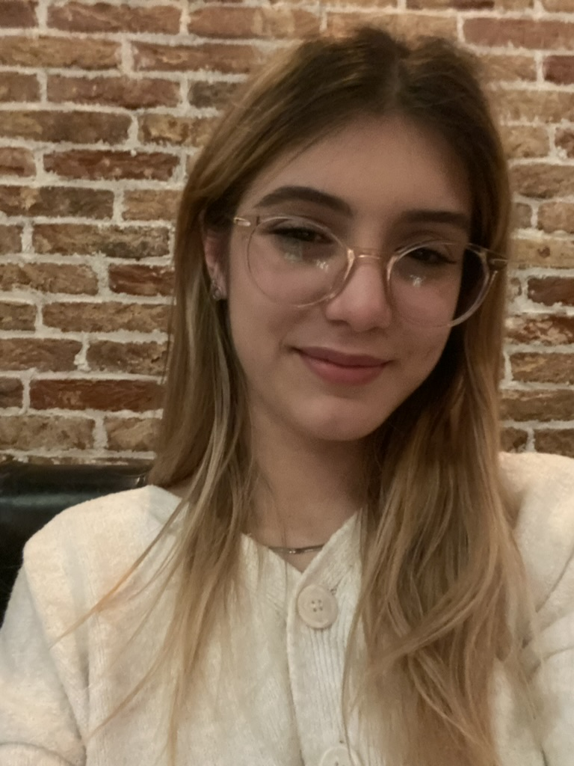
«Vlăduțu Daria-Elena»
«236578»
«FAI1.P1.-01_2023»
RETAKE
[photo]
Learning Log
«2022-2023» «A»
Design by Marvin Damstra

Slide 2
How To Use
This Template
As a student at Breda University of Applied Sciences studying to become a professional, you are required to provide evidence that demonstrates your professional learning and growth during the block. This template is intended to provide you with a well-structured and organised format for doing this effectively. Keep in mind that certain competencies may require you to update your evidence every week, and others may have only be relevant during a particular week or two.
With the evidence you present here teachers should get a clear and comprehensive overview of your progress, how you’ve engaged with feedback, as well as your general attitude and performance as a student and as an aspiring data professional.
Note that number and size of text boxes and how they are organized on each slide may be modified as needed. It is up to you to decide what layout is most effective for the content you are providing. You may also add slides if needed, but try to be as economical as possible, i.e. quality over quantity. Focus on the things that are the most significant and meaningful.
You are also free to stylise this template to improve the graphic design and visual appeal, but please remember its purpose: to provide evidence of your progress towards becoming a professional developer. Changes should only enhance and extend the information, and may never subtract. I.e. do not delete anything or change the order of things. If in doubt, seek approval from your teachers!

Slide 3
Section A
NOT IN BLOCK A – IGNORE THIS SLIDE
A
Goal Setting
Notes:
MUST BE UPDATED EVERY WEEK
This is simply a log (journal) of what you do each day, and what you learn from it. It is your responsibility to update this regularly and frequently. Be sure to include working links to any specific evidence you are referencing (and make sure that you share your docs with the teaching team). Note: some of the required information may be captured in production documents such as your work log or peer reviews.
In such cases, you simply need to provide links to those artifacts and may include any explanatory comment or reflection you feel is appropriate.
(Some reflection is almost always a good idea as it provides the foundation for Section C.)

Slide 4
Section B
B
Progress Log
Notes:
MUST BE UPDATED EVERY WEEK
This is simply a log (journal) of what you do each day, and what you learn from it. It is your responsibility to update this regularly and frequently. Be sure to include working links to any specific evidence you are referencing (and make sure that you share your docs with the teaching team).
Note: some of the required information may be captured in production documents such as your work log or peer reviews. In such cases, you simply need to provide links to those artifacts and may include any explanatory comment or reflection you feel is appropriate.
(Some reflection is almost always a good idea as it provides the foundation for Section C.)

Slide 5
1
Week 1 - Log
1/2
What did you do?
Reflection
What goal(s) did you set for this week?
Complete the assignments on time
Set up my computer workspace for programming
Read the creative brief
Start learning Python
What have you actually been able to do?
Most of the goals. However, I only completed some of my assignments on time.
Showcase the evidence of your progress (production artifacts, short descriptions-links-pictures animated gifs, etc.)
https://github.com/BredaUniversityADSAI/2023-24a-fai1-adsai-dariavladutu236578/blob/main/Exercises/VladutuDaria_GitHubExercise
https://github.com/BredaUniversityADSAI/2023-24a-fai1-adsai-dariavladutu236578/blob/main/Introduction to Programming with Python/1. Variables.ipynb
https://github.com/BredaUniversityADSAI/2023-24a-fai1-adsai-dariavladutu236578/blob/main/Introduction to Programming with Python/2. Conditional execution.ipynb
How did the week go?
I went fine, but I was a bit overwhelmed.
What went well?
I was able to complete most of the material from each day.
I managed to install the Python environment in order.
What didn’t go so well?
I am still learning how to manage my time properly so I can keep up with the workload.
What did you learn?
Philosophy of AI, history of AI, some theory about Information Literacy and Public Speaking, some basics of programming (Variables and Conditionals), the role of data scientist
What could be added as an Action point looking forward to next week?
Start working on the AI presentation and read what I didn’t finish of the AIMA

Slide 6
1
Week 1 - Feedback
2/2
Team, individual, peer, workshop feedback
[Reviewer] Feedback
Response to Feedback

Slide 7
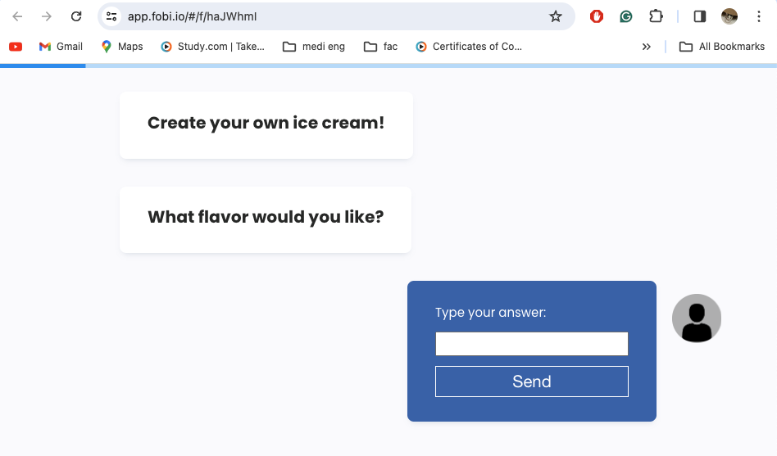
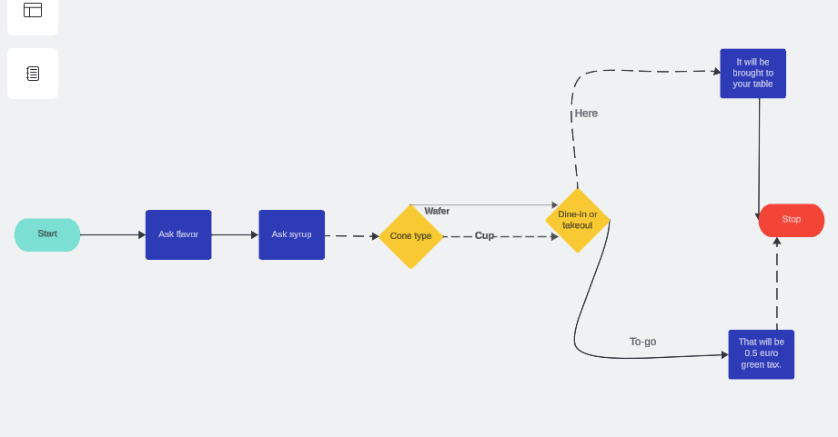
2
Week 2 - Log
1/3
What did you do?
What goal(s) did you set for this week?
Complete all of the quizzes for DataLab days before the deadline
Do a lot of Python exercises
Catch up on missing work from the week beforehand
Do the readings and the in-class tasks on DataLab days
What have you actually been able to do?
I completed the quizzes faster than I was, however, I still only managed to complete only 1 in time before the DataLab
I solved Python exercises and continued an extra-curricular course on Python (by Codecademy)
I caught up on some work (some was left in favor of the prioritization of other tasks)
I completed 95% of my readings
I completed the DataLab tasks
Showcase the evidence of your progress (production artifacts, short descriptions-links-pictures animated gifs, etc.)
https://lucid.app/lucidspark/41edea95-0500-4d2a-81f9-e3d2a0b9c02c/edit?invitationId=inv_35e62adc-3e83-412b-abef-b3d29d153af6&page=0_0
https://app.fobi.io/ - /f/haJWhmI

Slide 8
2
Week 2 - Log
2/3
Reflection
How did the week go?
The week went well, especially from an emotional standpoint because what we started studying this week made me excited and motivated for the future. Although I was quite tired, I pushed through and am continuously searching for motivation.
What went well?
Because my friends are visiting me, I got a boost of motivation and energy and I am trying to focus all of my energy on school as well as on my physical and emotional well-being. This makes me hopeful for the future.
What didn’t go so well?
I am still struggling sometimes to be focused on my tasks, but I am on my way to improving myself in this aspect.
What did you learn?
I learned about various AI models, the Turing Test, programming concepts and the basics of AI taxonomy.
What could be added as an Action point looking forward to next week?
Research into the topic of AI in Science Fiction and start working on the presentation design itself.

Slide 9
2
Week 2 - Feedback
3/3
Team, individual, peer, workshop feedback
Irene van Blerck: Try to slit up the tasks in the Work log into smaller tasks and update the time formats in there. Fill in Learning log
Response
I started filling in what was missing from the learning log and split my main tasks into smaller, more manageable tasks, as well as prioritizing these split up tasks in order to maximize my efficiency and make sure I have the deliverables required by the end of the block.

Slide 10
3
Week 3 - Log
1/2
What did you do?
Reflection
What goal(s) did you set for this week?
This week I want to finish my presentation by Thursday;
Journal and meditate more;
Deepen my python knowledge by doing extra exercises and readings;
Catch up with any missing work in the weekend
Complete all of the quizzes for DataLab days before the deadline
What have you actually been able to do?
I was able to complete most of my goals for this week, besides the test video recording og my “AI in Science Fiction presentation”.
Showcase the evidence of your progress (production artifacts, short descriptions-links-pictures animated gifs, etc.)
https://github.com/BredaUniversityADSAI/2023-24a-fai1-adsai-dariavladutu236578/blob/main/Exercises/VladutuDaria_GitHubExercise
https://github.com/BredaUniversityADSAI/2023-24a-fai1-adsai-dariavladutu236578/blob/main/Deliverables/Iris Recognition .pdf
How did the week go?
The week was good overall. I was a bit anxious about how the presentation would go, especially because we had to present it in front of the rest of the class.
What went well?
I was pretty confident in my presentation subject (Iris Recognition System using AI), and was overall excited about what I learned.
Meditating helped me with my anxiety.
What didn’t go so well?
I felt a bit overwhelmed this week.
What did you learn?
I learned a lot about how iris recognition using Artificial Intelligence works, the components of such a system and where it is used.
What could be added as an Action point looking forward to next week?
Putting more time into taking care of myself and uploading my work on time to Github.

Slide 11
3
Week 3 - Feedback
2/2
Team, individual, peer, workshop feedback
[Reviewer] Feedback
Response

Slide 12
4
Week 4 - Log
1/2
What did you do?
Reflection
What goal(s) did you set for this week?
Complete my work log better
Set up a virtual machine for Windows on my computer
Set up PowerBi and start doing the course to learn about the usage of the program
Gather data for research questions
Revise notebooks 5,6,7, and 8 for Python exam
What have you actually been able to do?
I managed to revise for the exam and set up my virtual machine for Windows. Additionally, I polished my work log. However, I could not complete the rest of my tasks due to prioritising studying for the exam itself.
Showcase the evidence of your progress (production artifacts, short descriptions-links-pictures animated gifs, etc.)
https://github.com/BredaUniversityADSAI/2023-24a-fai1-adsai-dariavladutu236578/blob/main/Deliverables/DataLab prep./236578_VladutuDaria_Week4DataLab1_1.docx
https://github.com/BredaUniversityADSAI/2023-24a-fai1-adsai-dariavladutu236578/blob/main/Exercises/Certificates/Power BI Certificate.pdf
https://github.com/BredaUniversityADSAI/2023-24a-fai1-adsai-dariavladutu236578/blob/main/Deliverables/DataLab prep./VariablesDataLabPreparation.pbix
How did the week go?
The week went by quite fast due to the workload assigned by the school, as well as by myself to me.
What went well?
I enjoyed installing the virtual machine for Windows on my macOS since I had to get a little creative and get around setting it up (I encountered some issues).
I liked revising for the exam since the concepts are not difficult and I like the idea that the material will be better memorised.
What didn’t go so well?
I started working and it was a little difficult to manage my time between my social, academic, and work life.
What did you learn?
I gained knowledge into sustainability and the interconnectedness of SDGs through lectures. I also started learning about PowerBI and how to craft a problem statement.
What could be added as an Action point looking forward to next week?
Dedicate more time developing a skill of my choice.

Slide 13
4
Week 4 - Feedback
2/2
Team, individual, peer, workshop feedback
[Reviewer] Feedback
Response

Slide 14
5
Week 5 - Log
1/2
What did you do?
Reflection
What goal(s) did you set for this week?
Work on CodingBat
Gathering data for the dashboard
Creating a report in PowerBI
What have you actually been able to do?
I managed to complete all of the goals set this week. I enjoyed working on the CodingBat problems and completed the first two sections before doing any of my other tasks. I fell a little behind on my progress on the dashboard in the middle of the week, but I managed to catch up on Friday.
Showcase the evidence of your progress (production artifacts, short descriptions-links-pictures animated gifs, etc.)
https://github.com/BredaUniversityADSAI/2023-24a-fai1-adsai-dariavladutu236578/blob/main/Exercises/Certificates/EDA in Power BI copy.pdf
https://github.com/BredaUniversityADSAI/2023-24a-fai1-adsai-dariavladutu236578/blob/main/Exercises/Certificates/Data Visualisation Certificate.pdf
https://github.com/BredaUniversityADSAI/2023-24a-fai1-adsai-dariavladutu236578/blob/main/Exercises/Certificates/CertificateOfCompletion_Learning Data Science Tell Stories With Data.pdf
How did the week go?
The week went by fast, without any particular occurrences. Seems like weeks go by faster as we further approach the end of the block.
What went well?
I enjoyed working on the CodingBat problems and therefore further developing my programming skills.
I started working on my PowerBI dashboard.
What didn’t go so well?
I fell a little behind on my tasks at the beginning of the week, but managed to catch up by Friday.
What did you learn?
I learned about the different SDGs and how to use Power Bi for visuals. I also revised on Statistics material, such as central tendency.
What could be added as an Action point looking forward to next week?
Work on the EDA, finalize the research question, gather data, and further work on my dashboard.

Slide 15
5
Week 5 - Feedback
2/2
Team, individual, peer, workshop feedback
[Reviewer] Feedback
Response

Slide 16
6
Week 6 - Log
1/2
What did you do?
Reflection
What goal(s) did you set for this week?
Work on my dashboard
Finish the CodingBat exercises
What have you actually been able to do?
I completed both goals set for this week.
Showcase the evidence of your progress (production artifacts, short descriptions-links-pictures animated gifs, etc.)
https://github.com/BredaUniversityADSAI/2023-24a-fai1-adsai-dariavladutu236578/blob/main/Exercises/DataLab Preparation Week 6, Lab I.jpeg
https://github.com/BredaUniversityADSAI/2023-24a-fai1-adsai-dariavladutu236578/blob/main/Exercises/CodingBat.png
https://github.com/BredaUniversityADSAI/2023-24a-fai1-adsai-dariavladutu236578/blob/main/Exercises/Screenshot 2.png
How did the week go?
The week was very interesting. I made a little bit of progress on my dashboard, but not as much as I would’ve wished to.
What went well?
I managed my time better this week by making a very organised schedule.
I completed the DataLab tasks on time.
I caught up with some of the courses for PowerBi.
I started reading a personal development book (‘Atomic Habits’ by James Clear)
What didn’t go so well?
I was struggling with my mental health for a bit. I did however get support from my friends and managed to get back on track with university tasks.
What did you learn?
I learned about regression and correlation, data distributions and calculating sample variances, as well as population variances.
What could be added as an Action point looking forward to next week?
I want to be more motivated in my work and develop myself more as a person. This motivation is what will fuel my working on my project.

Slide 17
6
Week 6 - Feedback
2/2
Team, individual, peer, workshop feedback
[Reviewer] Feedback
Response

Slide 18
7
Week 7 - Log
1/2
What did you do?
Reflection
What goal(s) did you set for this week?
Finish up my dashboard
Work on my StudentTemplate dashboard
Analyse the dashboard against the (CRISP-DM) model
Revise both CodingBat and Jupyter Notebooks
What have you actually been able to do?
I managed to make huge amounts of progress on my dashboard and interpret my research findings.
I also managed to revise both of the parts for my python exam, and work on Leet Code.
Showcase the evidence of your progress (production artifacts, short descriptions-links-pictures animated gifs, etc.)
https://github.com/BredaUniversityADSAI/2023-24a-fai1-adsai-dariavladutu236578/blob/main/Exercises/Leetcoat.png
https://github.com/BredaUniversityADSAI/2023-24a-fai1-adsai-dariavladutu236578/blob/main/Exercises/Screenshot 4.png
https://github.com/BredaUniversityADSAI/2023-24a-fai1-adsai-dariavladutu236578/blob/main/Deliverables/Python Exam.png
How did the week go?
The went quite well. I mainly focused on the Python exam and on my SGDs dashboard.
What went well?
I believe I passed my exam. On the CodingBat part, I did well. I am still unsure about the theoretical part.
Overall, I believe I am done with my dashboard.
What didn’t go so well?
I had difficulty understanding how to fill the Student Template dashboard and what it exactly is..
What did you learn?
I learned about user-friendly design, visuals in Power BI and the CRISP-DM data science cycle and successful predictions.
What could be added as an Action point looking forward to next week?
Polish up on my work and learning logs, and more importantly make the finishing touches on my dashboard.

Slide 19
7
Week 7 - Feedback
2/2
Team, individual, peer, workshop feedback
[Reviewer] Feedback
Response

Slide 20
8
Week 8 - Log
1/2
What did you do?
Reflection
What goal(s) did you set for this week?
Finish my dashboard
Come up with a solution for the EDA dashboard template
Finish up my Work log and Learning log
Create the data analysis in Python file
What have you actually been able to do?
This week, I achieved almost all of my goals, except for the data analysis file. While none of the work is perfect by any means, I dedicated a significant amount of work on all of them. I also made a lot of improvements on the Work and Learning logs.
Showcase the evidence of your progress (production artifacts, short descriptions-links-pictures animated gifs, etc.)
https://github.com/BredaUniversityADSAI/2023-24a-fai1-adsai-dariavladutu236578/blob/main/Deliverables/SDG Dashboard (1).pbix
https://github.com/BredaUniversityADSAI/2023-24a-fai1-adsai-dariavladutu236578/blob/main/Deliverables/Student Template.pbix
How did the week go?
The wee was very stressful since it was the last one of the block, and since I lost my file for the final presentation deliverable. I had to complete and refine many of my final deliverables, which left me exhausted.
What went well?
I successfully passed my Python exam (both the exercise and theoretical parts).
I was able to complete the Work and Learning log to my liking, and caught up on some minor tasks that I had to do
What didn’t go so well?
My SDGs presentation file got corrupted and a lot of my work was lost. However, I managed to put some of it back together, although not to the level it was before.
What did you learn?
I learned the importance of consistency and a good task schedule.
What could be added as an Action point looking forward to next week?
For my next block, I plan on being more efficient and as organized as possible in order to avoid stressful situations like this week was.

Slide 21
8
Week 8 - Feedback
2/2
Team, individual, peer, workshop feedback
[Reviewer] Feedback
Response

Slide 22
Section C
C
Progress
Intended Learning Outcomes
Notes:
MUST BE COMPLETED IN WEEK 8, BUT SHOULD BE UPDATED REGULARLY
This is where you link your evidence to each of the Intended Learning Outcomes of this block.

Slide 23
ILO 1
1
Professional Practice
The student demonstrates professional behavior as well as accountability and ethics in the application of industry best practices for planning, communication, collaboration, and responsible execution of work assignments.

Slide 24
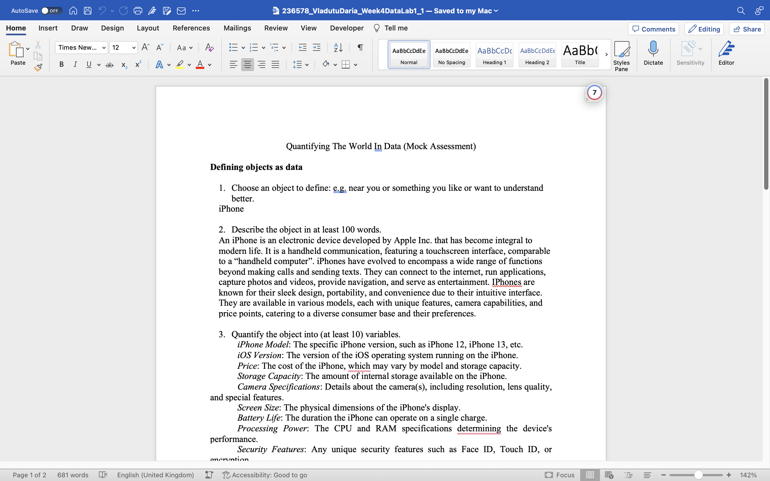
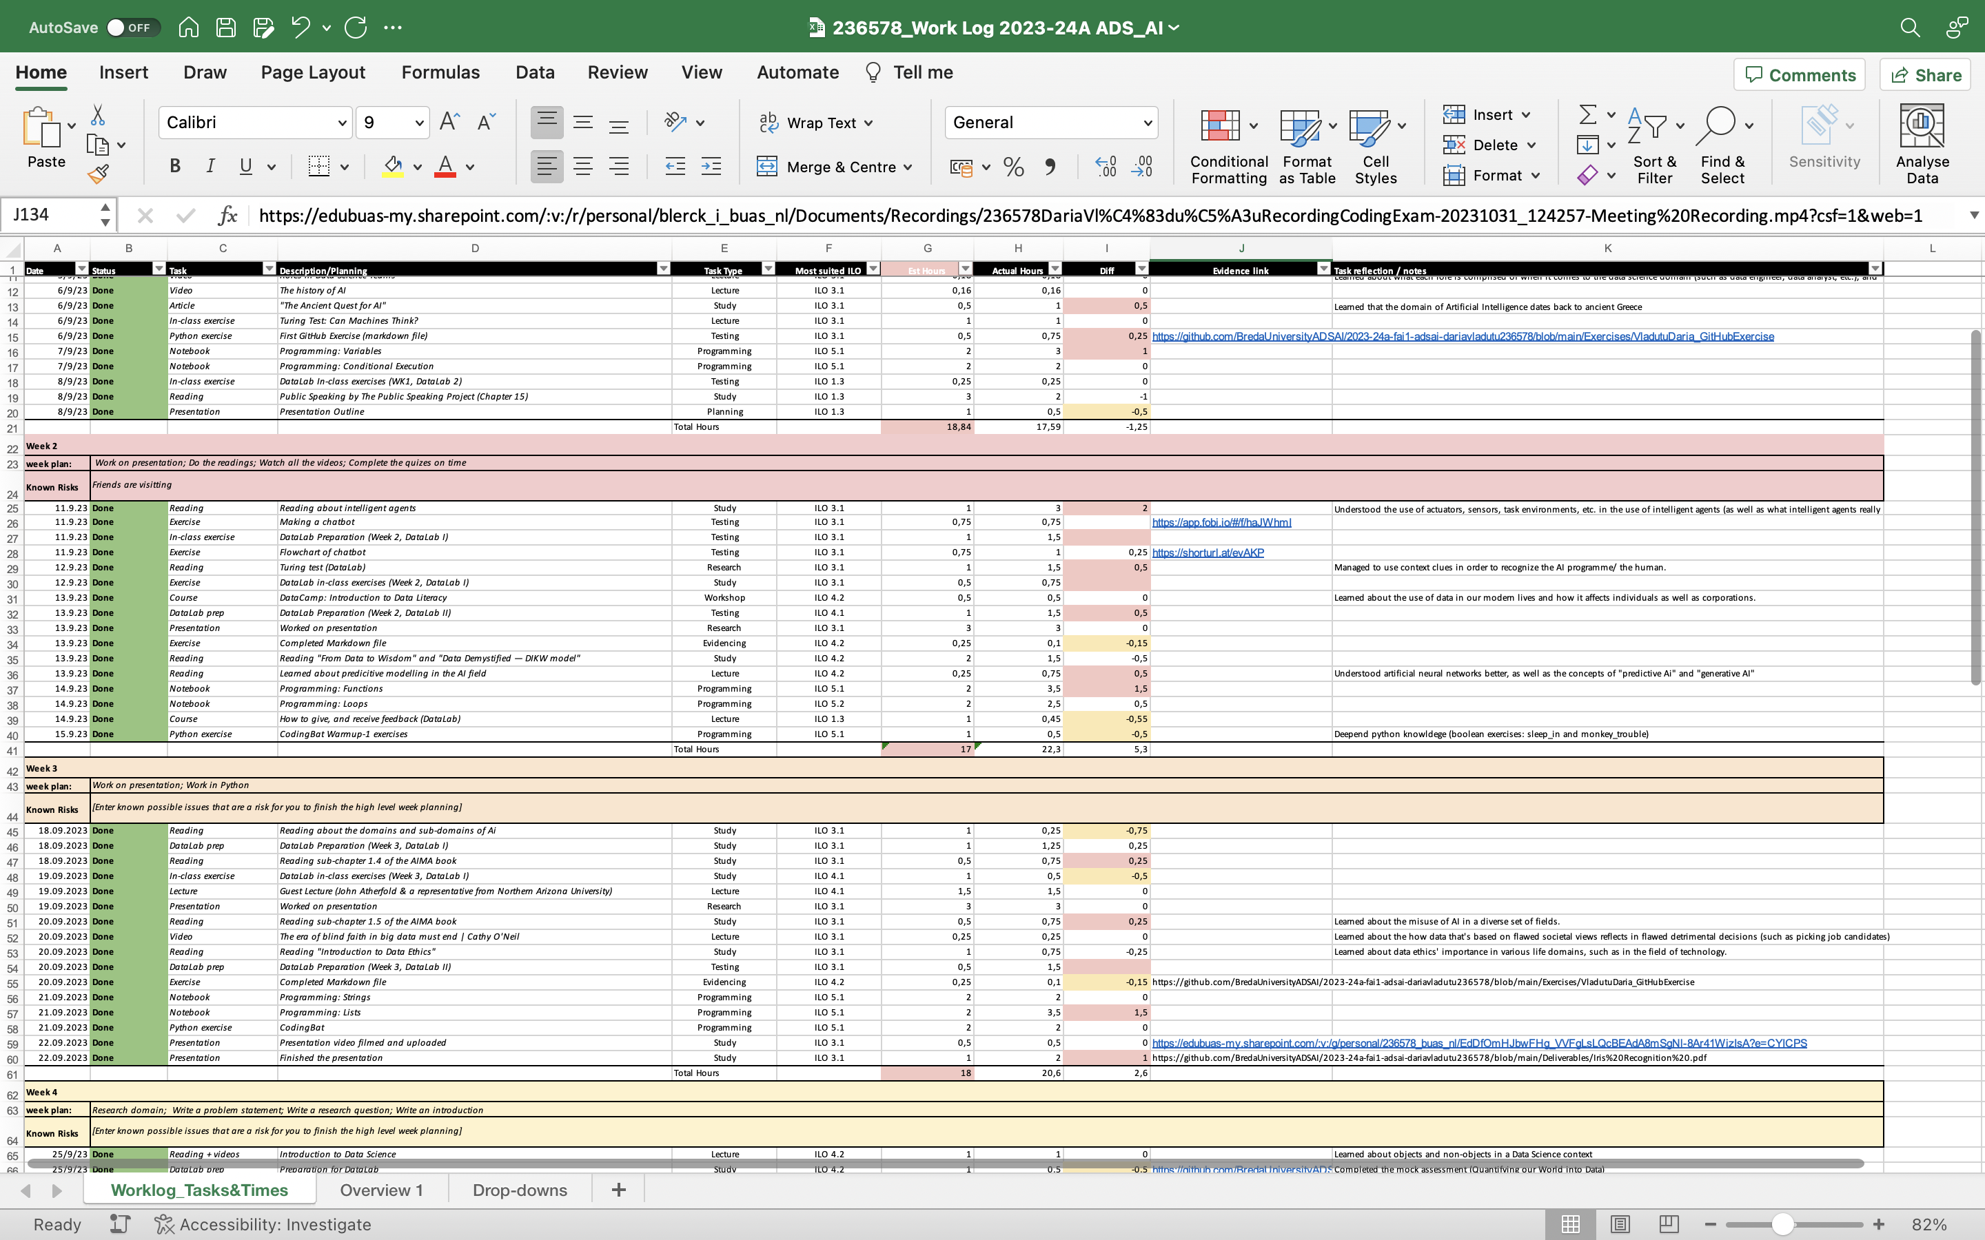
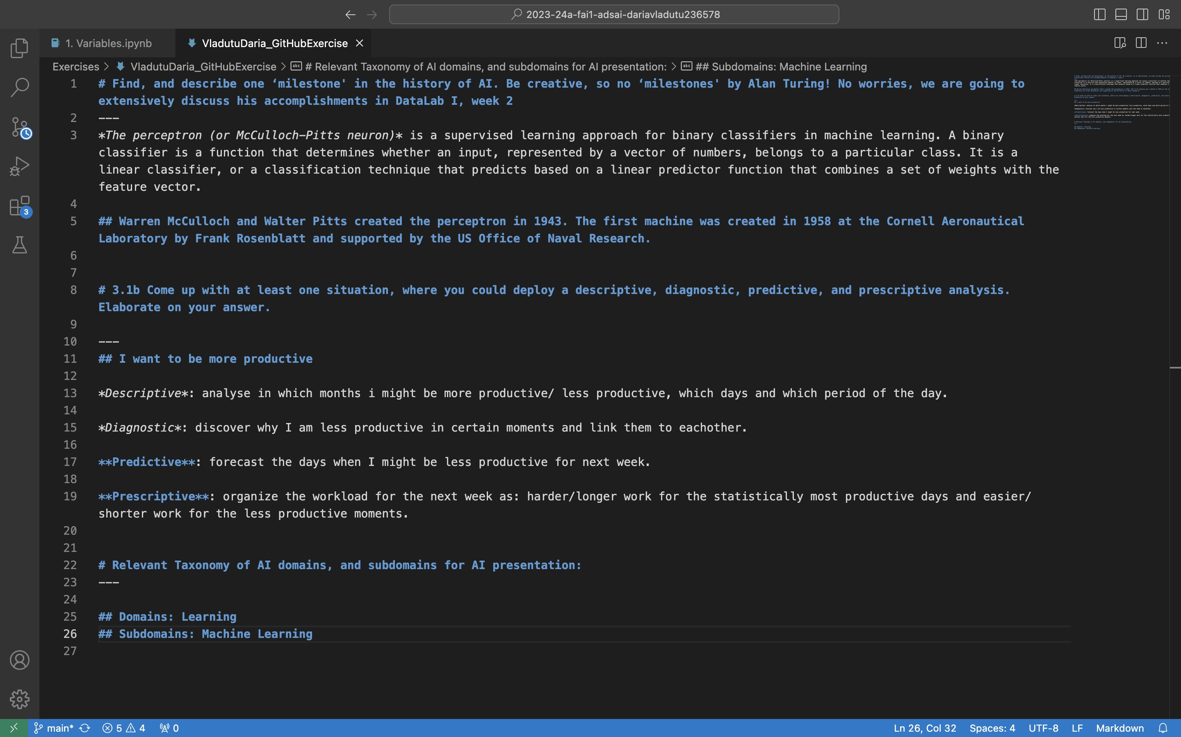
ILO 1
Professional Practice
The student demonstrates professional behavior as well as accountability and ethics in the application of industry best practices for planning, communication, collaboration, and responsible execution of work assignments.
1/1
1.3
The student attends the Datalab sessions, and submits work, adhering to defined guidelines and processes in the Creative Brief.
(Poor) I have made sure to fill in the absentee form before 9 a.m.
(Sufficient) I discussed with Bram and Irene on the 1st of March 2024 and again on the 24th of May 2024. They agreed that I could use the DataLab Preparations of Block C (the quizzes) as evidence for the criteria of ILO 1.3; I have updated my Work Log on a regular basis.
(Good) Refer to Block B ILO 2 for proof of proffesional standards regarding writing.
https://github.com/BredaUniversityADSAI/2023-24a-fai1-adsai-dariavladutu236578/blob/main/Deliverables/DataLab%20prep./._236578_VladutuDaria_Week4DataLab1_1.docx
https://github.com/BredaUniversityADSAI/2023-24a-fai1-adsai-dariavladutu236578/blob/main/Deliverables/236578_Work%20Log%202023-24A%20ADS_AI.xlsx
https://github.com/BredaUniversityADSAI/2023-24a-fai1-adsai-dariavladutu236578/blob/main/Exercises/._VladutuDaria_GitHubExercise

Slide 25
ILO 2
2
Professional Practice / Attitude
The student demonstrate self-exploration and personal development, good academic practices in learning how to learn and the acquisition of professional knowledge through research, study, analysis, applied practice, discussion and reporting.

Slide 26
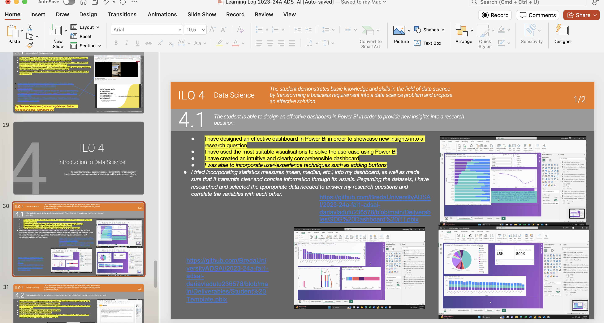
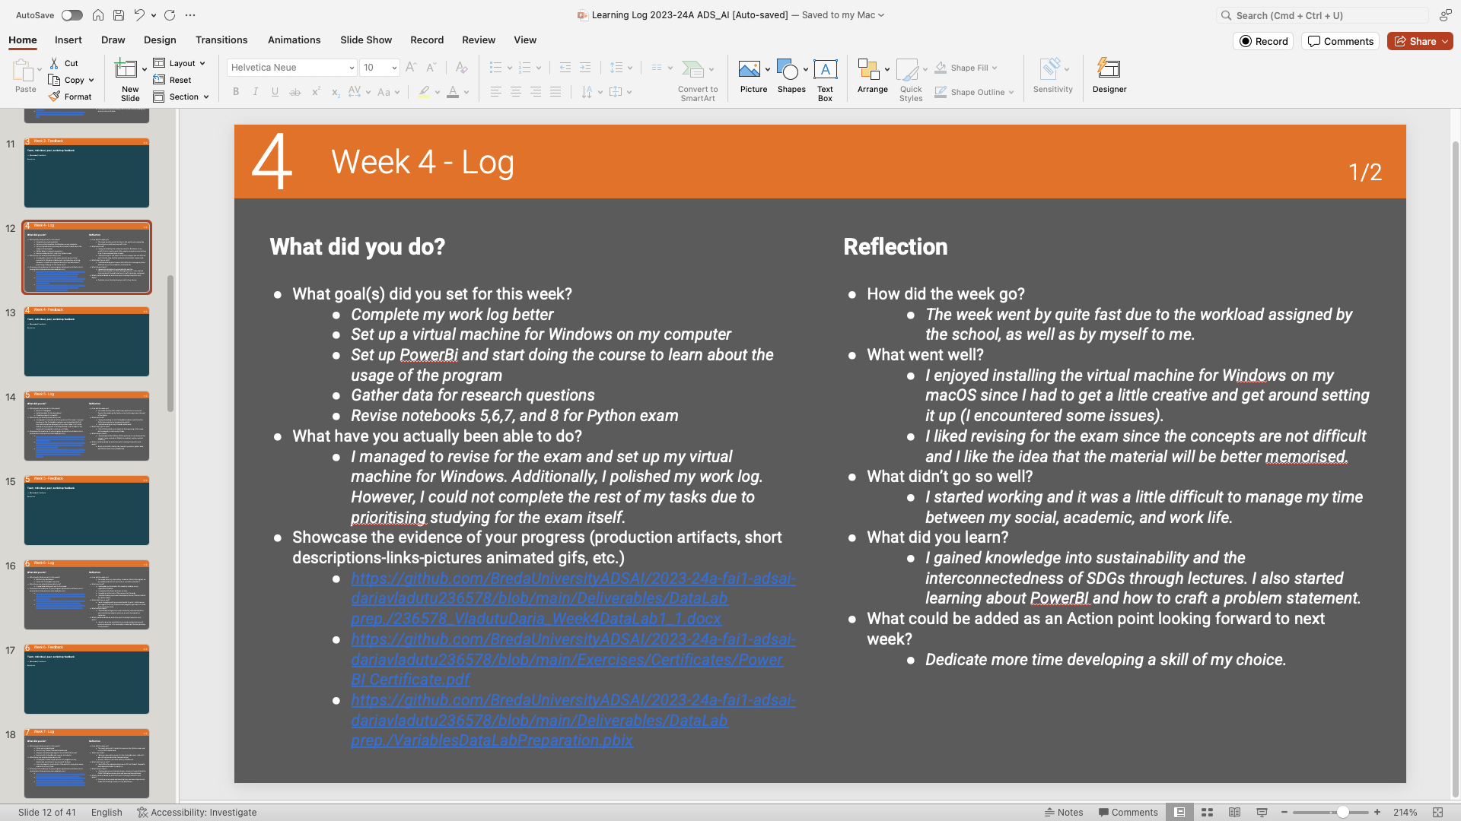
ILO 2
Professional Practice
The student demonstrate self-exploration and personal development, good academic practices in learning how to learn and the acquisition of professional knowledge through research, study, analysis, applied practice, discussion and reporting.
1/1
2.4
The student reports on learning progress and updates plans in a well-written, concise format with appropriate visual communication, guided by active engagement with feedback.
(POOR) The Learning Log is complete, and each week I have documented the tasks at hand and what I have learned. There are no traces of plagiarism.
(INSUFFICIENT) I have tried to complete the work log to the best of my abilities and time devoted to the curriculum.
(SUFFICIENT) I have referenced all the links I could have possibly in the work log.
(GOOD) All references to important resources used are included.
(EXCELLENT) My writing style is professional and free of spelling and grammar mistakes.
https://github.com/BredaUniversityADSAI/2023-24a-fai1-adsai-dariavladutu236578/blob/main/Deliverables/Learning%20Log%202023-24A%20ADS_AI%20%5BAuto-saved%5D.pptx

Slide 27
ILO 3
3
Introduction to Artificial Intelligence
The student is able to identify, and analyze AI applications in fictional and real-life (business) scenarios by examining and applying relevant concepts from AI literature and theory.

Slide 28
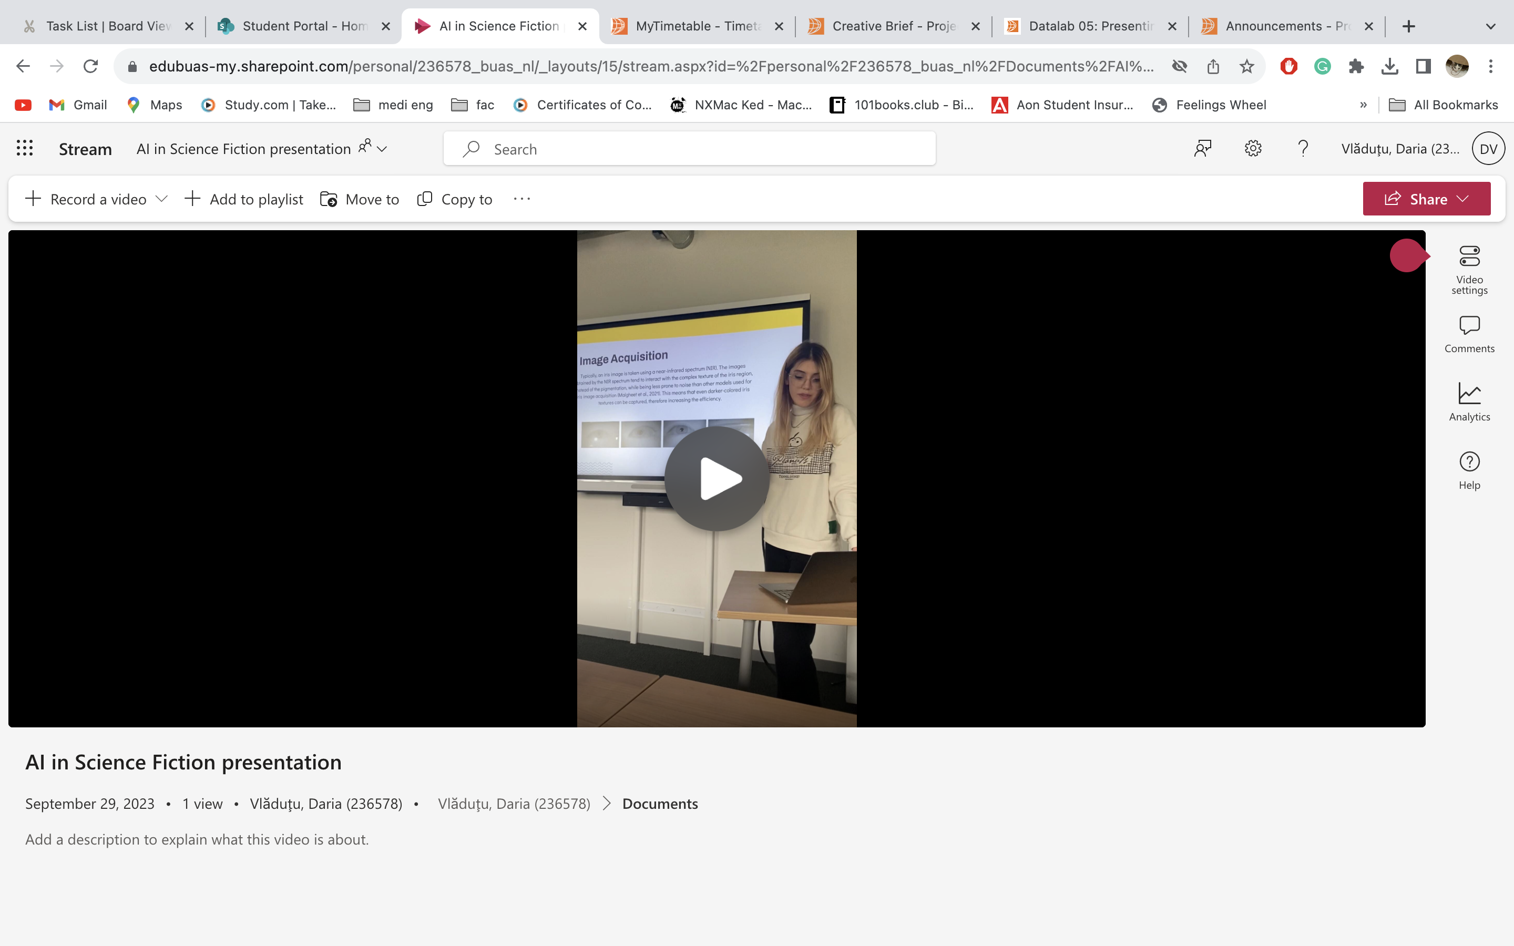
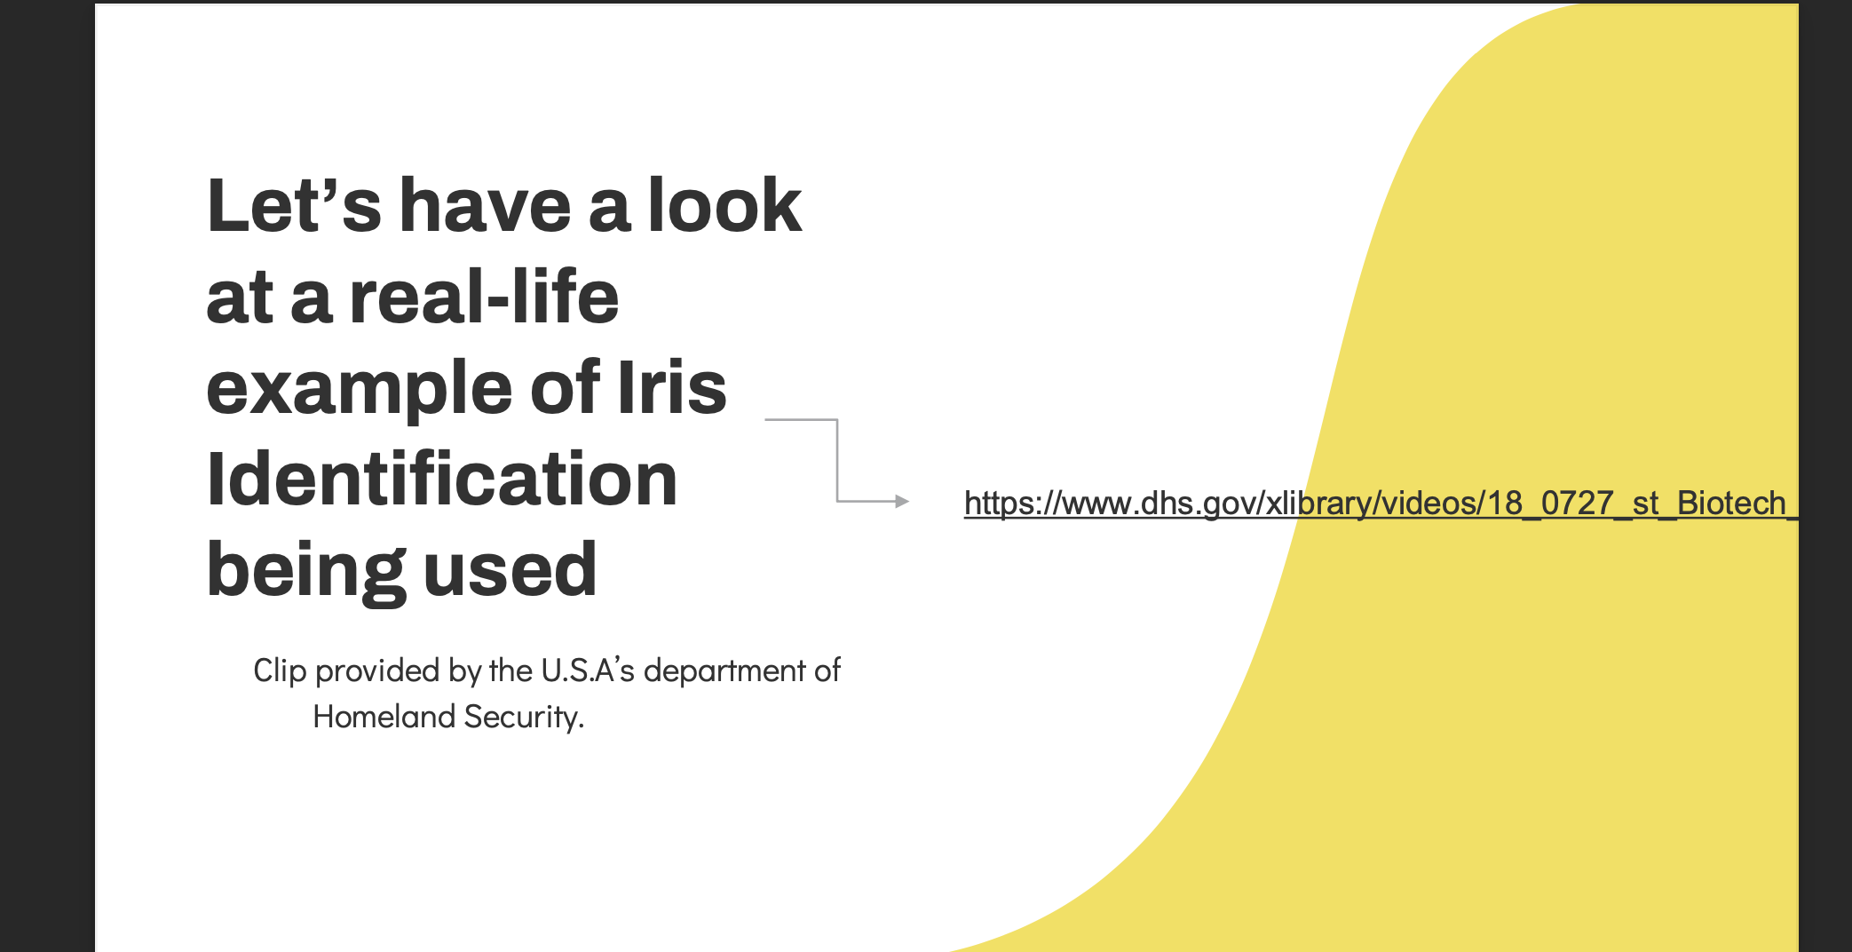
ILO 3
Introduction to Artificial Intelligence
The student is able to identify, and analyze AI applications in fictional and real-life (business) scenarios by examining and applying relevant concepts from AI literature and theory.
1/1
3.1
The student is able to identify, and analyze AI applications in fictional and real-life (business) scenarios by examining and applying relevant concepts from AI literature and theory.
(POOR) I have effectively communicated my findings in a 7-minute presentation
(INSUFFICIENT) I have analysed AI in both fiction and a business context and provided examples of its usage.
I have identified the AI topic of biometrics in the movie ‘Minority Report’, I have explained the concept and connected it to the subfields of the Taxonomy of AI.
(SUFFICIENT) I have evaluated the technical feasibility of the chosen topic by critically assessing its application within multiple real-life scenarios (such as its use in airport security). The list of refrences used is provided at the end of the presentation.
(EXCELLENT) I have expressed the potential ethical consequences of implementing the chosen AI topic in a business setting.
https://github.com/BredaUniversityADSAI/2023-24a-fai1-adsai-dariavladutu236578/blob/main/Deliverables/Iris%20Recognition%20.pdf
https://edubuas-my.sharepoint.com/personal/236578_buas_nl/_layouts/15/stream.aspx?id=%2Fpersonal%2F236578_buas_nl%2FDocuments%2FAI in Science Fiction presentation.MOV&referrer=StreamWebApp.Web&referrerScenario=AddressBarCopied.view

Slide 29
ILO 4
4
Introduction to Data Science
The student demonstrates basic knowledge and skills in the field of data science by transforming a business requirement into a data science problem and propose an effective solution.

Slide 30
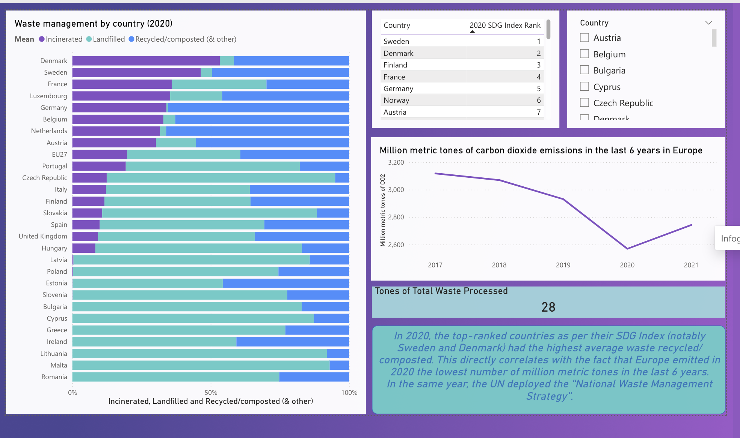
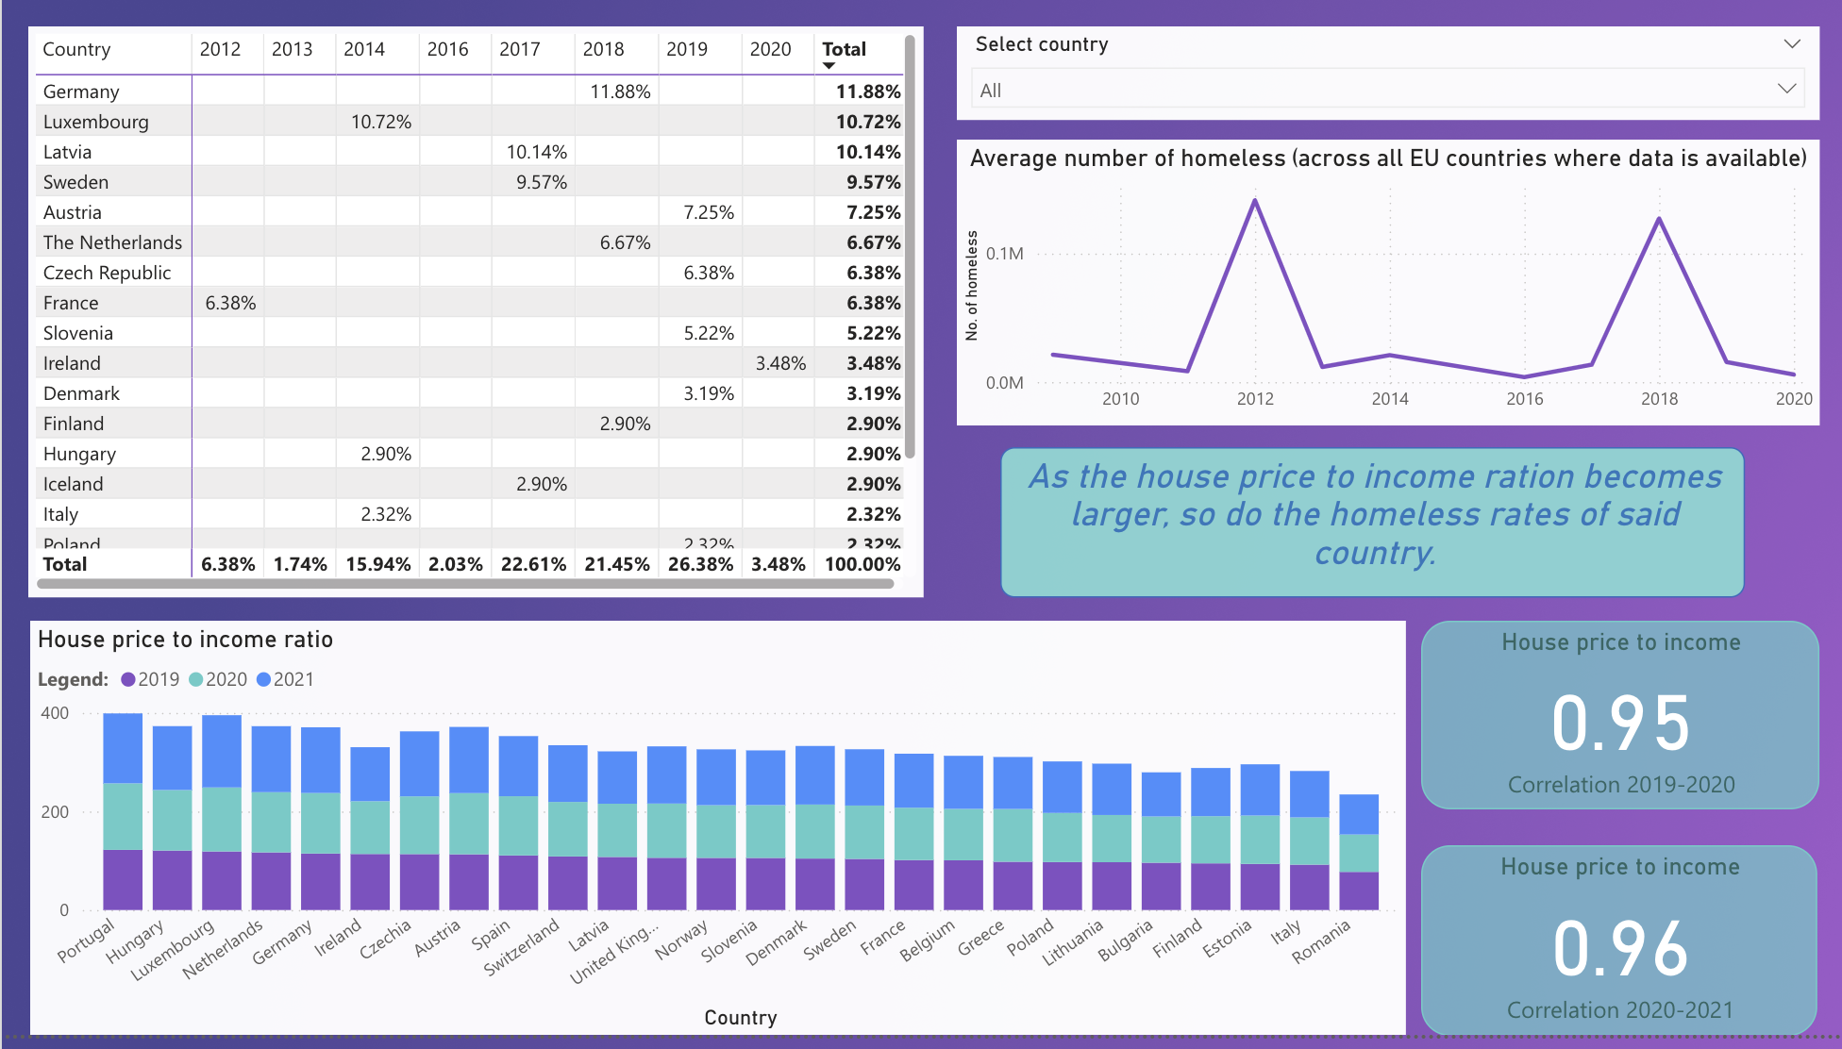
ILO 4
Data Science
The student demonstrates basic knowledge and skills in the field of data science by transforming a business requirement into a data science problem and propose an effective solution.
1/2
4.1
The student is able to design an effective dashboard in Power BI in order to provide new insights into a research question.
(POOR)I tried incorporating statistics measures (mean, median, etc.) into my dashboard (specifically when working with the columns in my dataset, where I predominantly used the mean to showcase insights into the data; additionally), as well as made sure that it transmits clear and concise information through its visuals. Regarding the datasets, I have researched and selected the appropriate data needed to answer my research questions and correlate the variables with each other.
(INSUFFICIENT) I have designed an effective dashboard in Power Bi in order to showcase new insights into a research question. I have used a correlation coefficient as a measure of association
I have used the most suitable visualisations to solve the use-case using Power Bi
(SUFFICIENT) I calculated and visually displayed the correlation coefficient between two variables in my dashboard
(GOOD) I have created an intuitive and clearly comprehensible dashboard.
I was able to incorporate user-experience techniques such as adding buttons and choosing the appropriate visualisations techniques. I wrote a clear conclusion which is a summary of my findings, and which takes into considerations the next phase of the CRISP-DM cycle.
(EXCELLENT) I have proved through my student dashboard that I am able to recognize the data science lifecycle as an iterative process and that I can clearly distinguish between the phases of CRISP-DM.
LINK TO DASHBOARD
LINK TO DATASETS USED
LINK TO STUDENT DASHBOARD

Slide 31
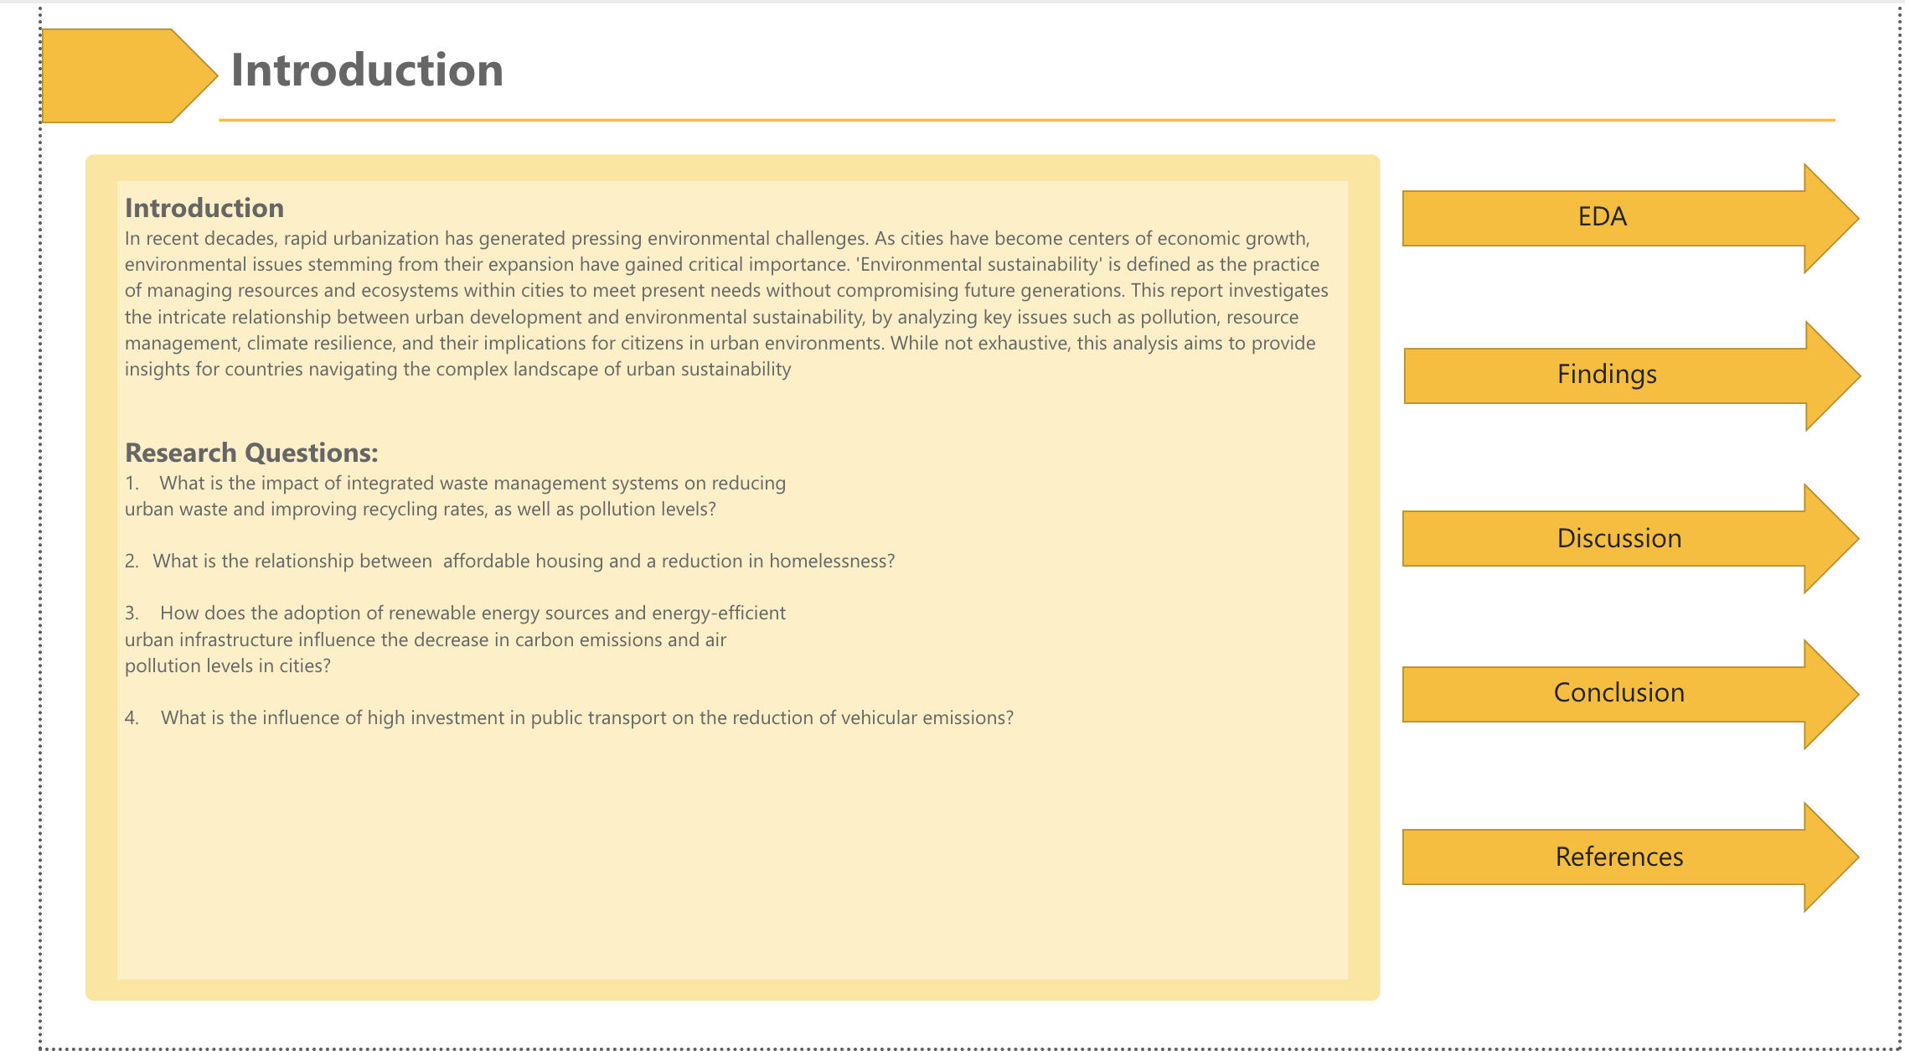
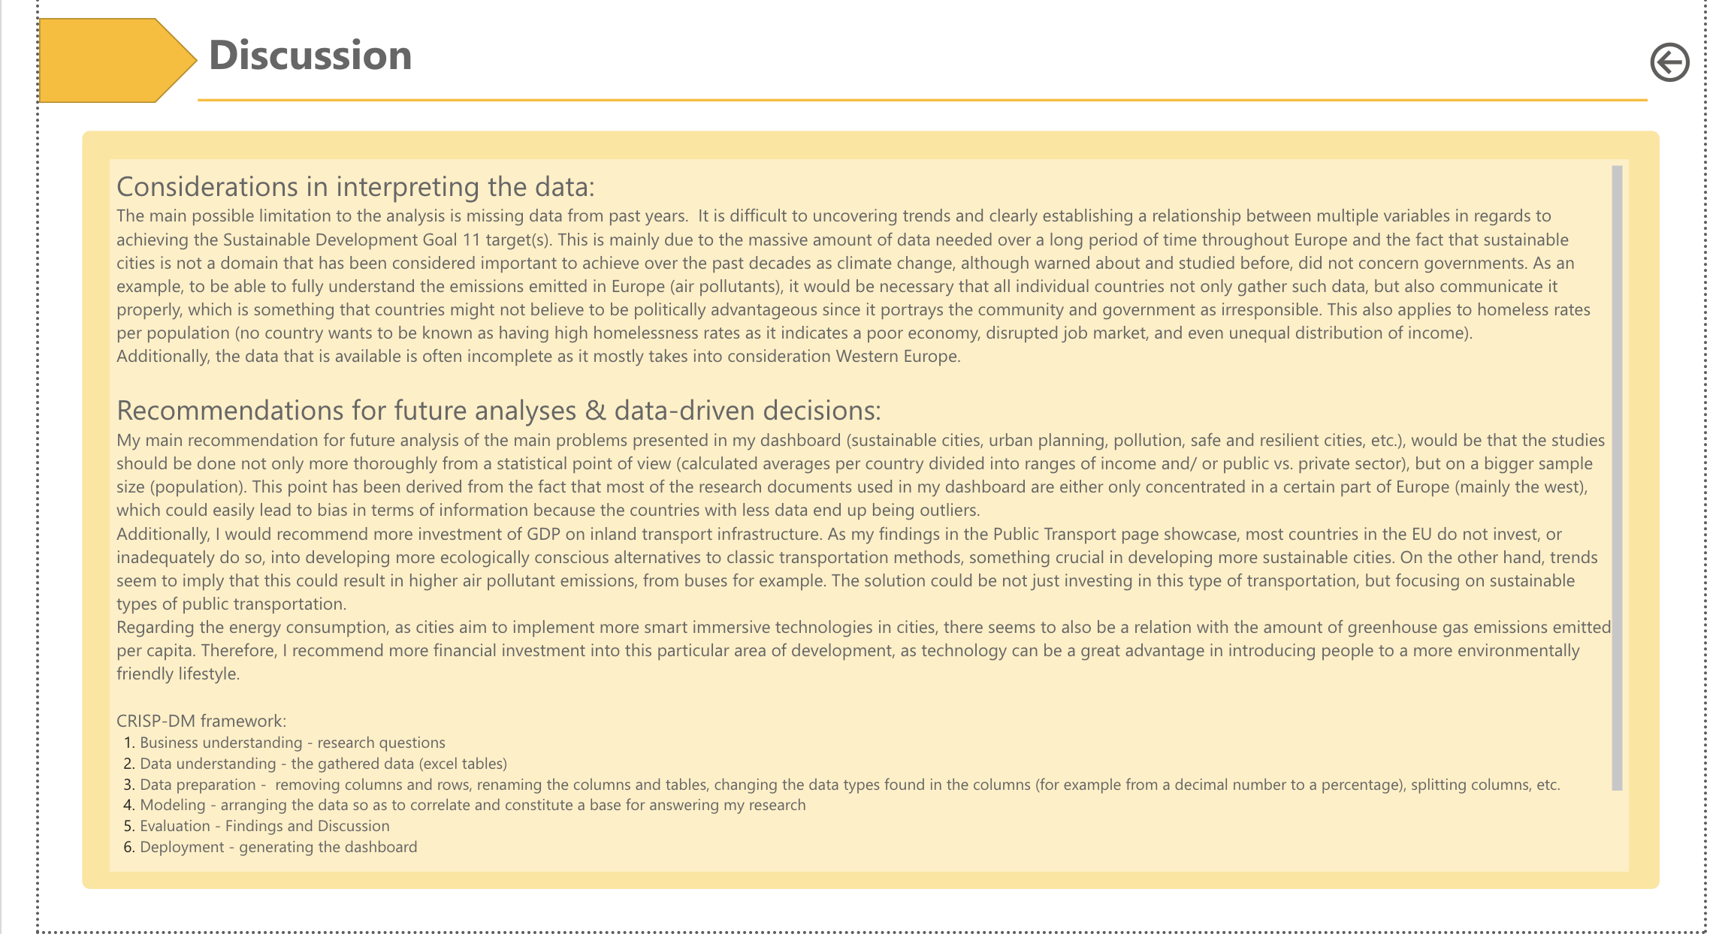
ILO 4
Data Science
The student demonstrates basic knowledge and skills in the field of data science by transforming a business requirement into a data science problem and propose an effective solution.
2/2
4.2
The student applies the data science concepts learned and use a standard data science tool to solve a project task.
(POOR) I was able to construct data-driven research questions related to the SDG 11. I formulated a problem statement and a coherent introduction with a relevant closing statement.
(SUFFICIENT)I was able to select, clean and transform multiple appropriate datasets to answer the data-driven research question, using the Sustainable Development Goals databank
(SUFFICIENT) I was able to propose a solution to the problem at hand with a simple linear regression
(GOOD) I was able to present and interpret my findings to the best of my abilities after conducting my reserach.
(EXCELLENT) I was able to discover new patterns in the dataset which are not related to the original research question and propose next steps for future research.
LINK TO STUDENT DASHBOARD

Slide 32
ILO 5
5
Introduction to Programming with Python
The student is able to write Python programs, to solve a wide range of introductory programming challenges and perform basic data analysis, using fundamental programming concepts.

Slide 33
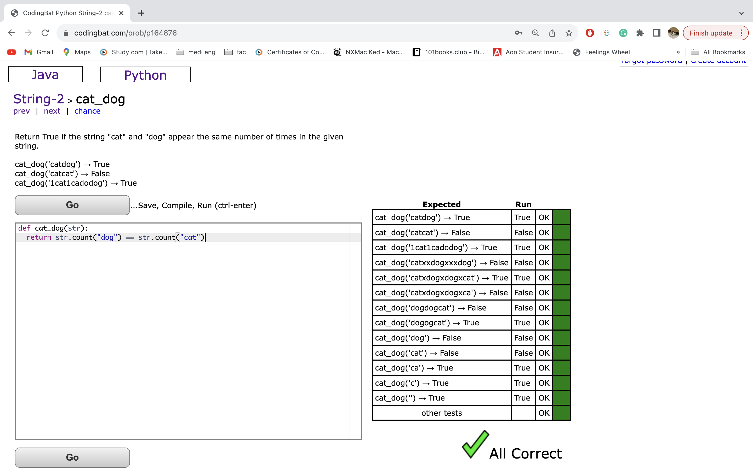
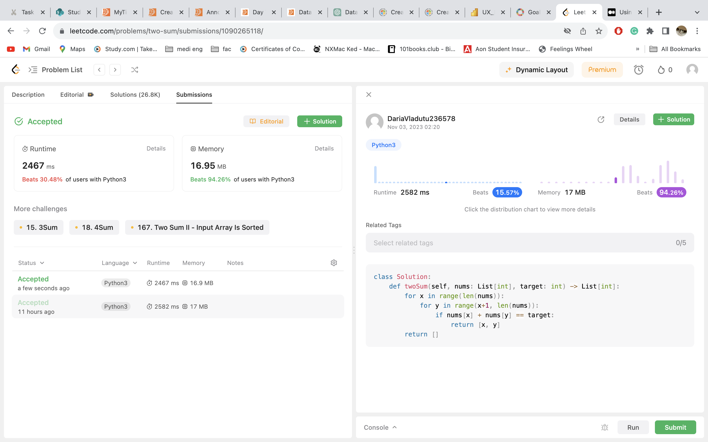
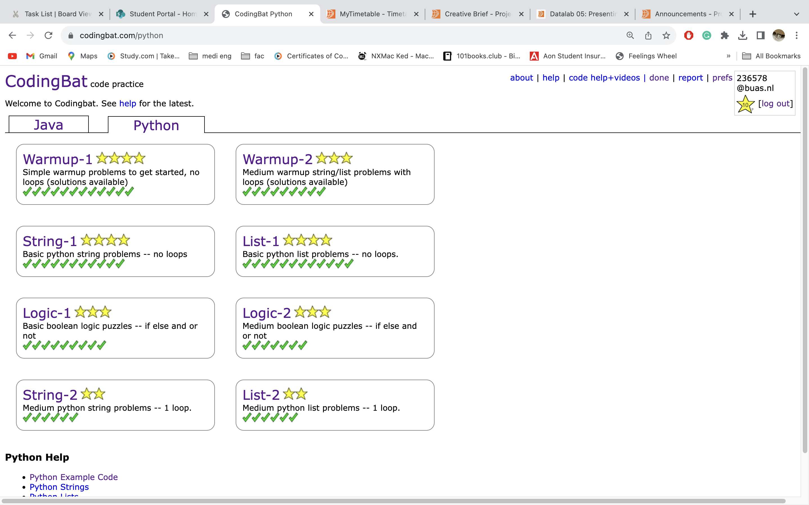
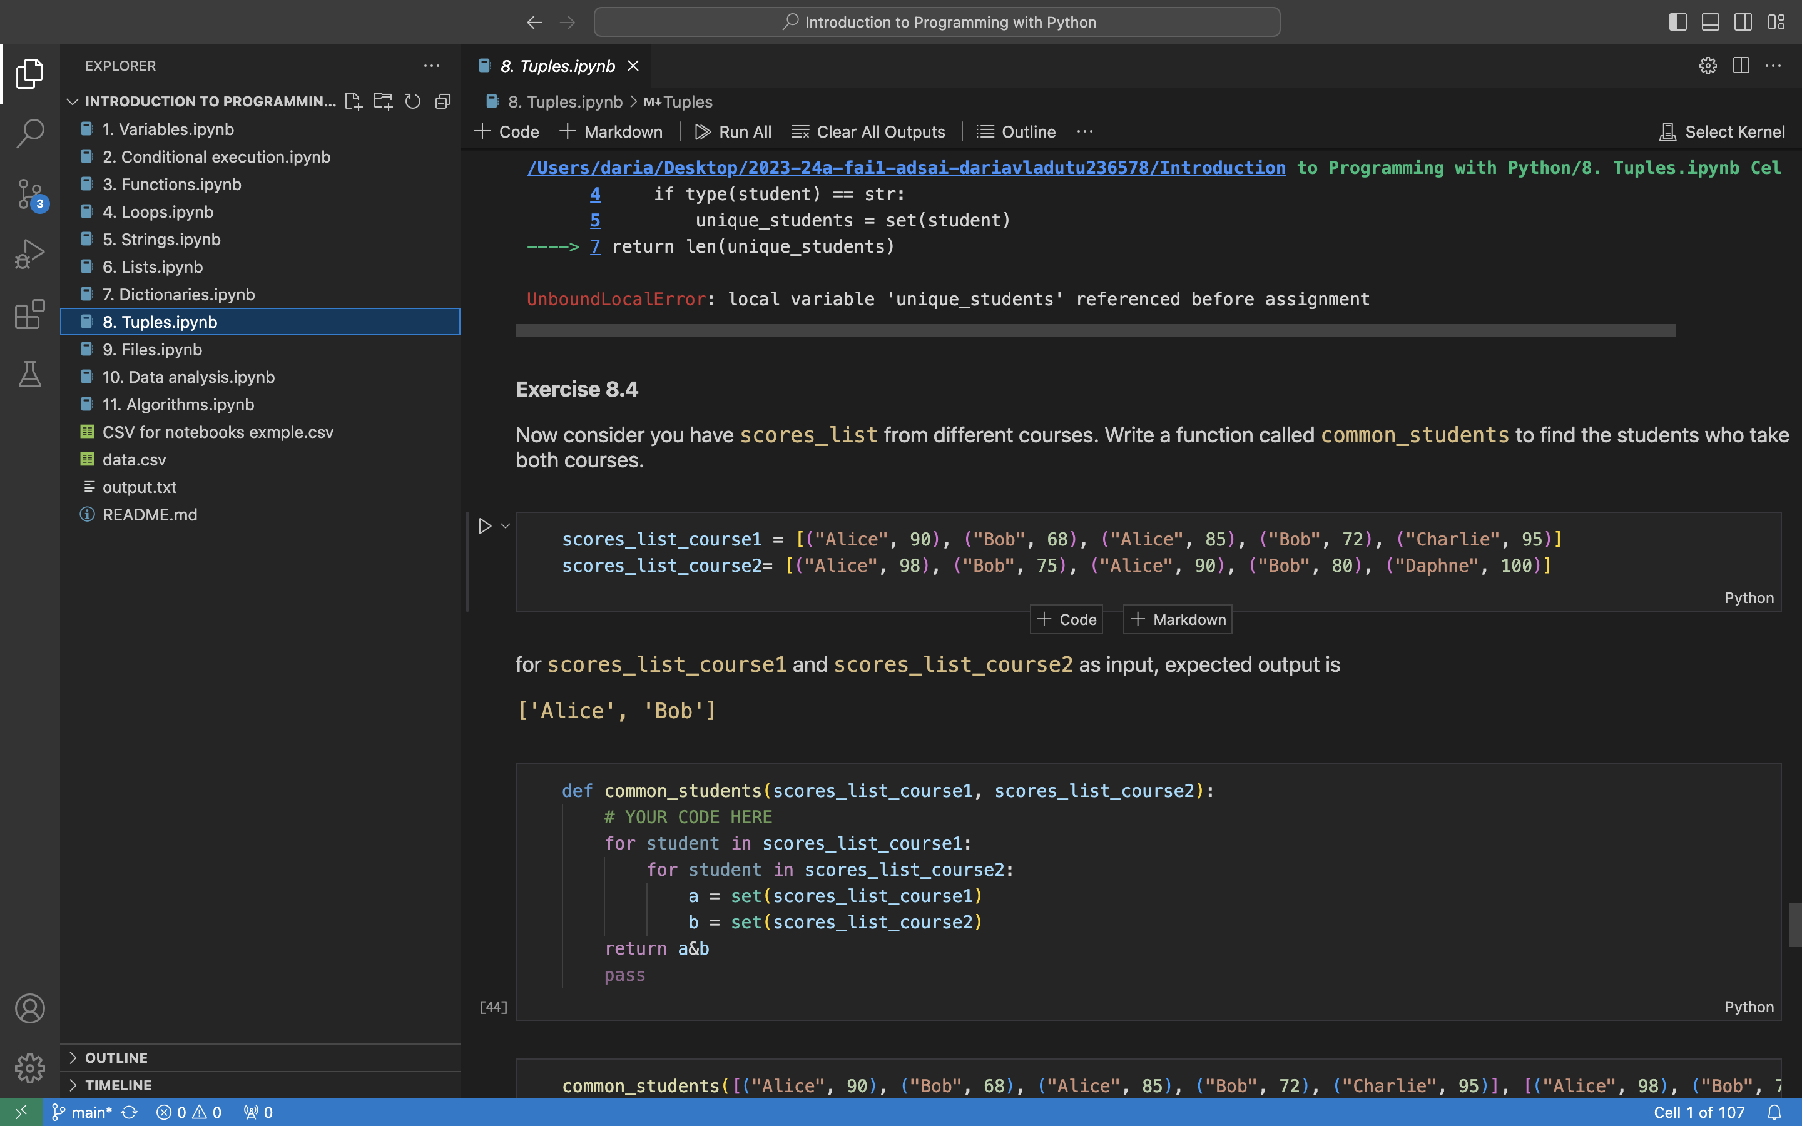
ILO 5
Introduction to Programming with Python
The student is able to write Python programs, to solve a wide range of introductory programming challenges and perform basic data analysis, using fundamental programming concepts.
1/1
5.1
The student is able to write Python programs, to solve a wide range of introductory programming challenges and perform basic data analysis, using fundamental programming concepts.
I have completed all the CodingBat problems, as well as completed as much of the Python Notebooks as possible (some problems were left unsolved as I didn’t know how to answer them).
I have passed the written part of the Python exam
I have understood the Python fundamentals and algorithms fully and almost fully understood data structures (still having troubles with Tuples).
https://github.com/BredaUniversityADSAI/2023-24a-fai1-adsai-dariavladutu236578/blob/main/Deliverables/Python%20Exam.png
https://github.com/BredaUniversityADSAI/2023-24a-fai1-adsai-dariavladutu236578/blob/main/Introduction%20to%20Programming%20with%20Python/6.%20Lists.ipynb

Slide 34
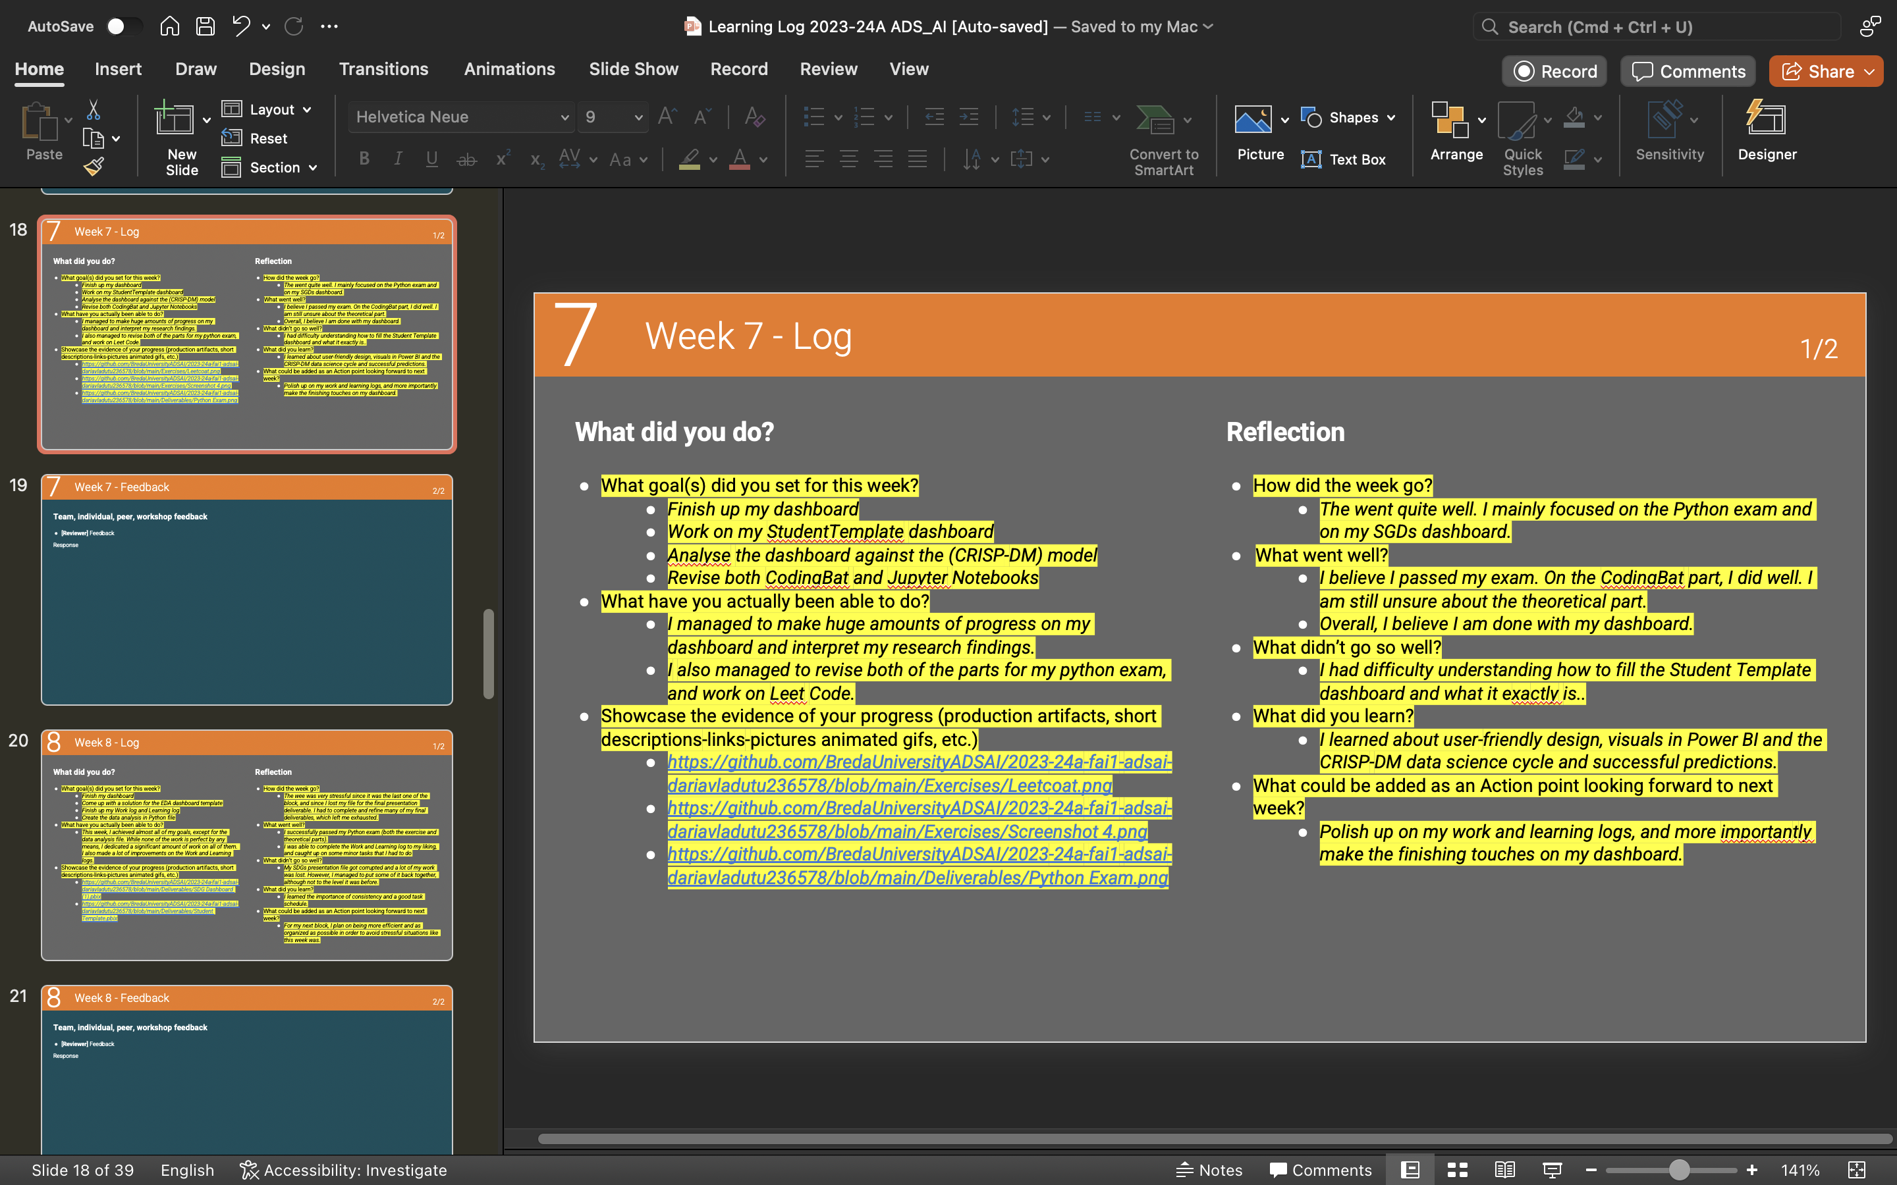
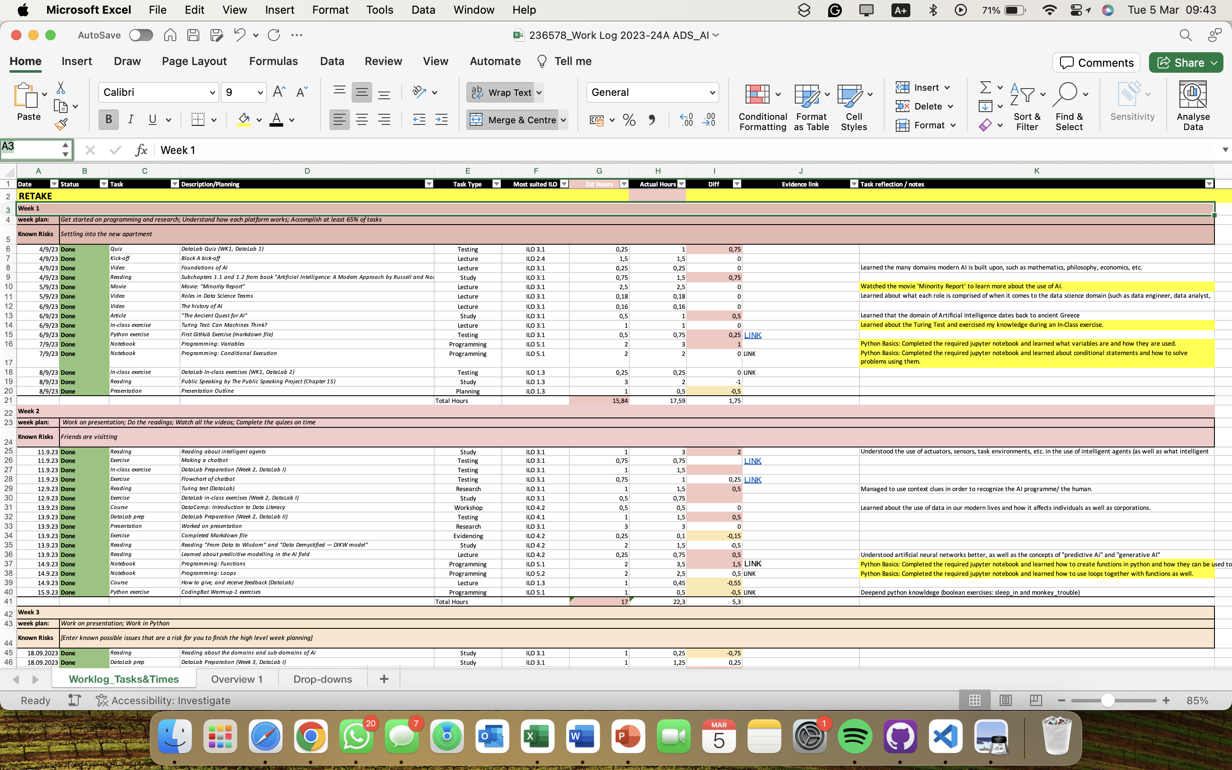
RETAKE
Changes made regarding the second opportunity
I have highlited in bright yellow all the changes made to both my Learning Log and my Work Log.
I have modified all of Section B (Progress Log) and provided more detailed explanation of the tasks at hand, as well as multiple links for evidencing my work.
I rewrote Section C (Progress ILOs), except for ILO 5, to showcase what I achieved for each Intended Learning Outcome, provided the necessary links to evidence my work, and made sure to structure the material in an easy to understand tone in order to make the structure of my work as easy to comprehend as possible.
I have added descriptions for every task at hand in the Work Log that needed a description.
I have modified the visualisations on my final SDG dashboard to better convey the information (see next slides for explanations)

Slide 35
Changes made regarding the second opportunity
RETAKE
‘Waste Management’ tab
Changed all titles and variable names to better the visualisations and convey the appropriate information
Added a ‘Tones of Total Waste Processed’ card to put information into perspective in regards to the other visualisations and variables

Slide 36
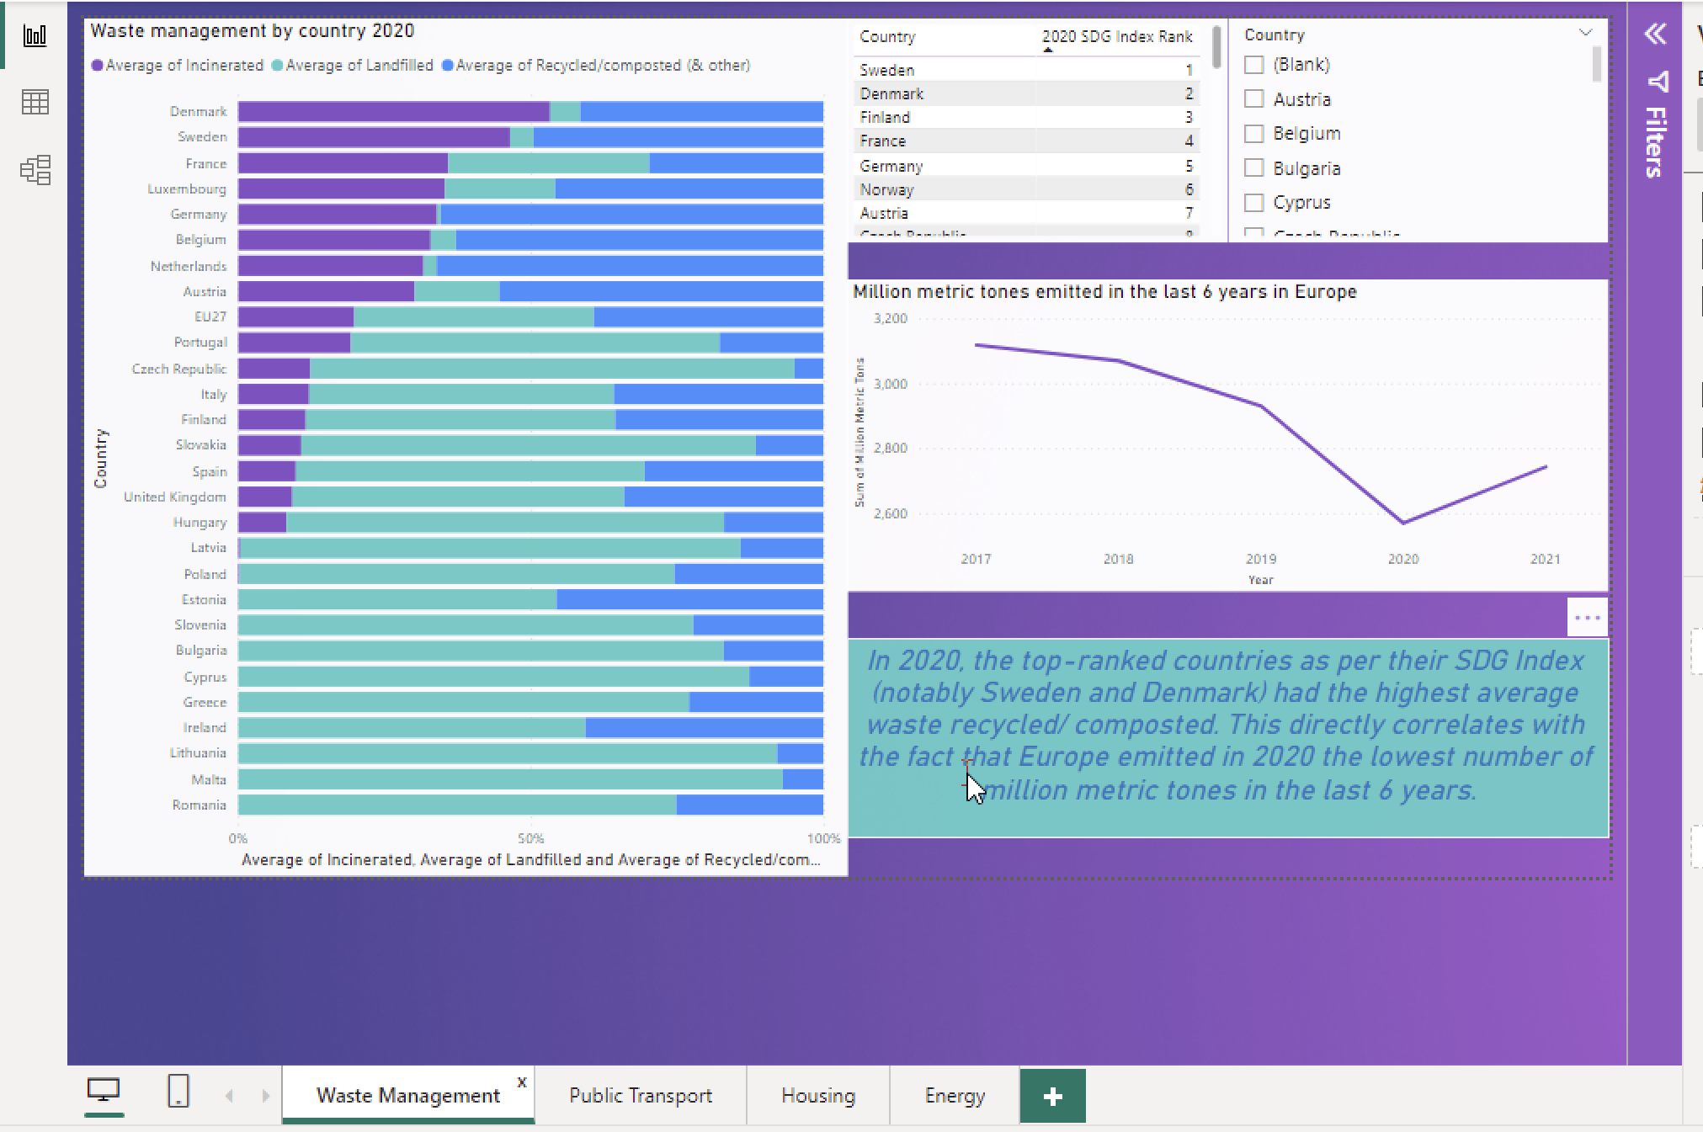
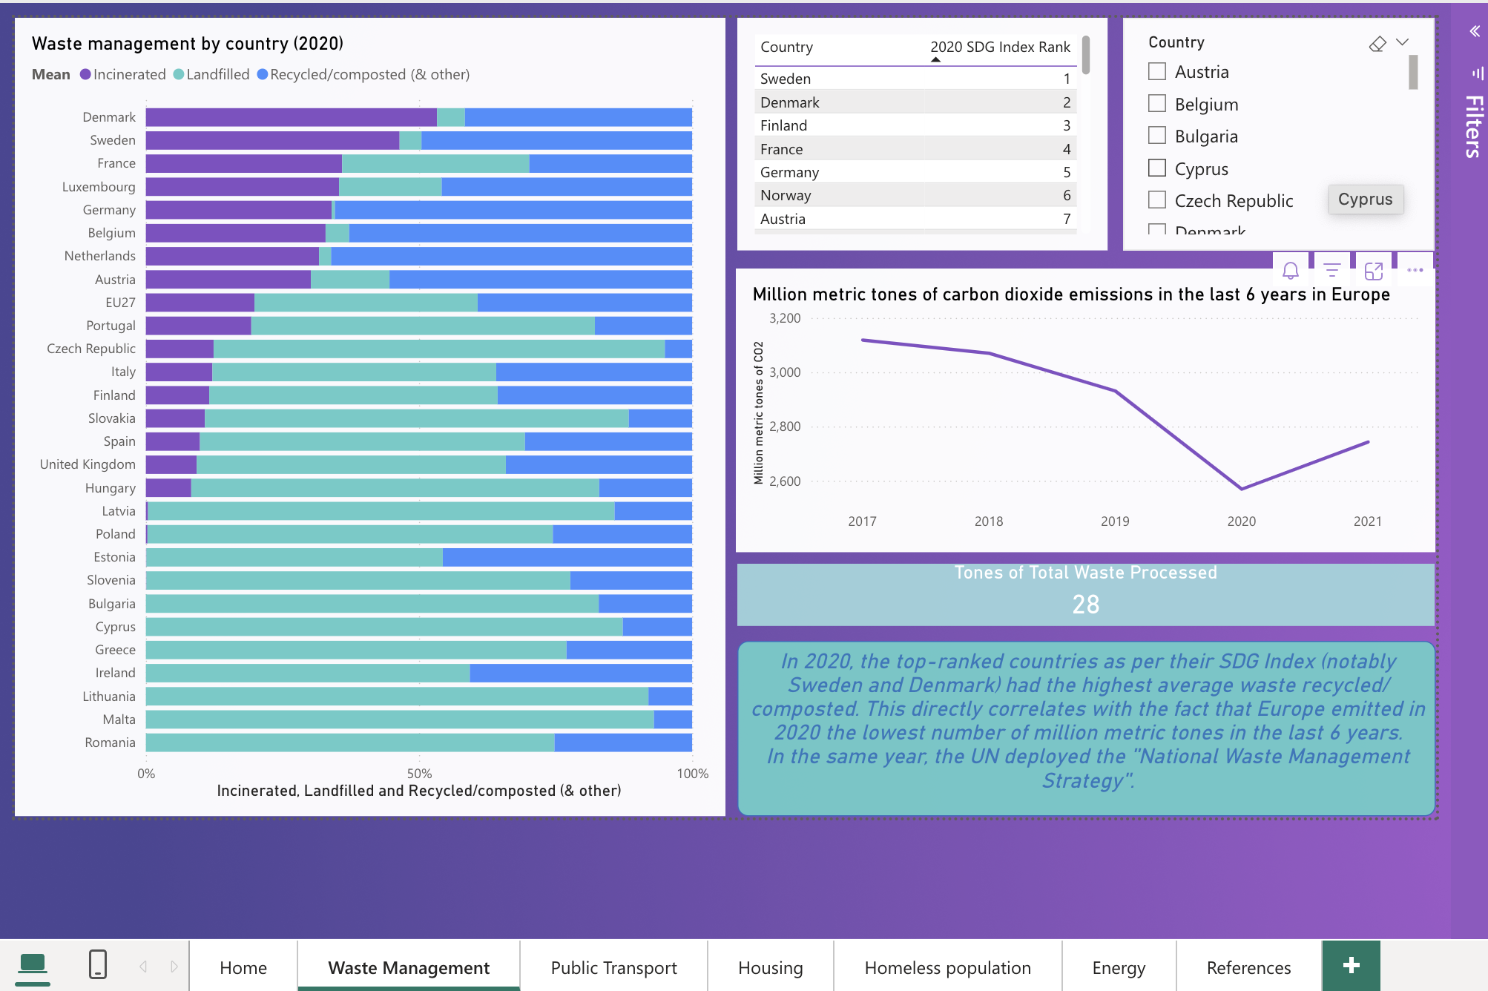
Changes made regarding the second opportunity – Before and After - Dashboard
RETAKE
Before:
After:

Slide 37
Changes made regarding the second opportunity
RETAKE
‘Public Transport’ tab
Changed all titles and variable names to better the visualisations and convey the appropriate information
Changed the Stacked column and line chart to a Treemap visualisation to better showcase the countries’ spending of their GDP on inland transportation infrastructure.
Changed the ’million metric tones of CO2’ line to a ‘mean percentage of GDP spending across all countries’ line as I deemed it unfitting before and the variables not quite relating.
Added a text card to show the most important insights.

Slide 38
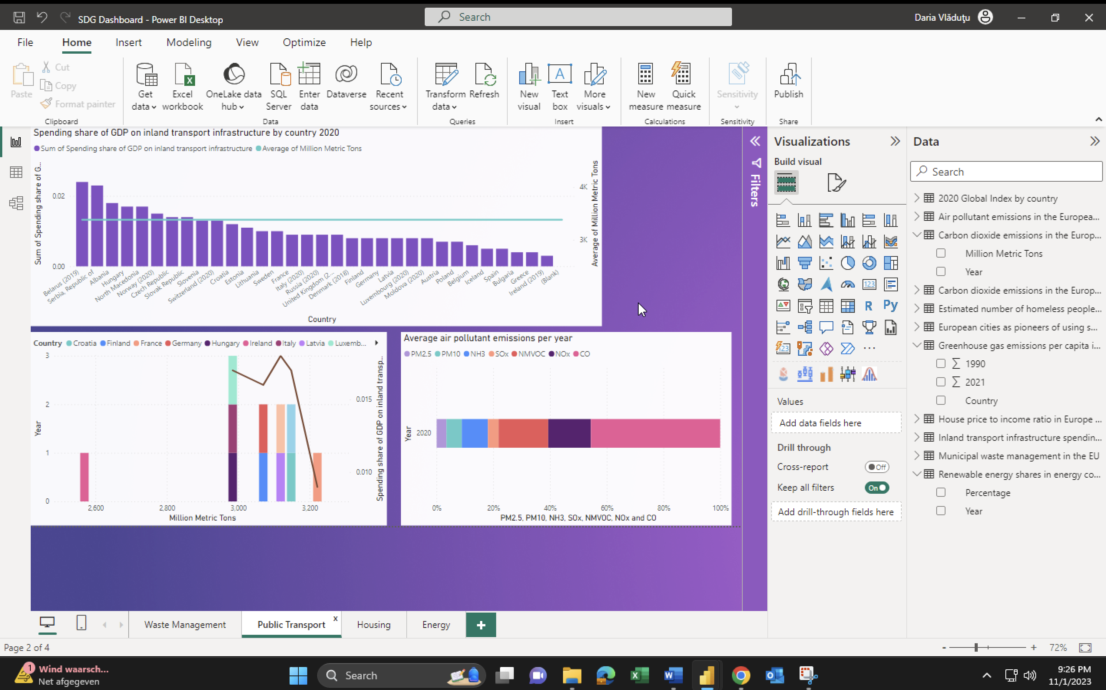
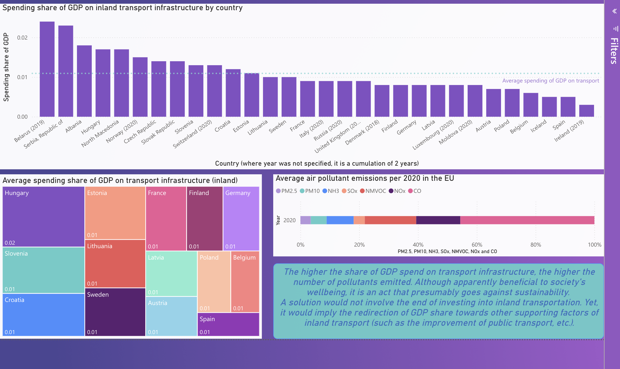
Changes made regarding the second opportunity – Before and After - Dashboard
RETAKE

Slide 39
Changes made regarding the second opportunity
RETAKE
‘Housing’ tab
Changed all titles and variable names to better the visualisations and convey the appropriate information.
Removed the Pie chart as it was not conveying any useful information and it was cluttered.
Removed the cards calculating the sums as they were also not showcasing any useful informationa and it was unclear what the sums represented.
Showed the correlation between homelessness and housing prices-to-income ratio by using a line chart to present the average number of homeless people throughout the year.
Added a stacked bar chart to showcase the house prices to income ratio of 2019-2021.
Added a matrix to individually present the number of homeless people across different countries and years as a percentage of the population.
Calculated the Pearson correlation coefficient between the number of homeless and the years (once for 2019-2020 and then for 2020-2021).

Slide 40
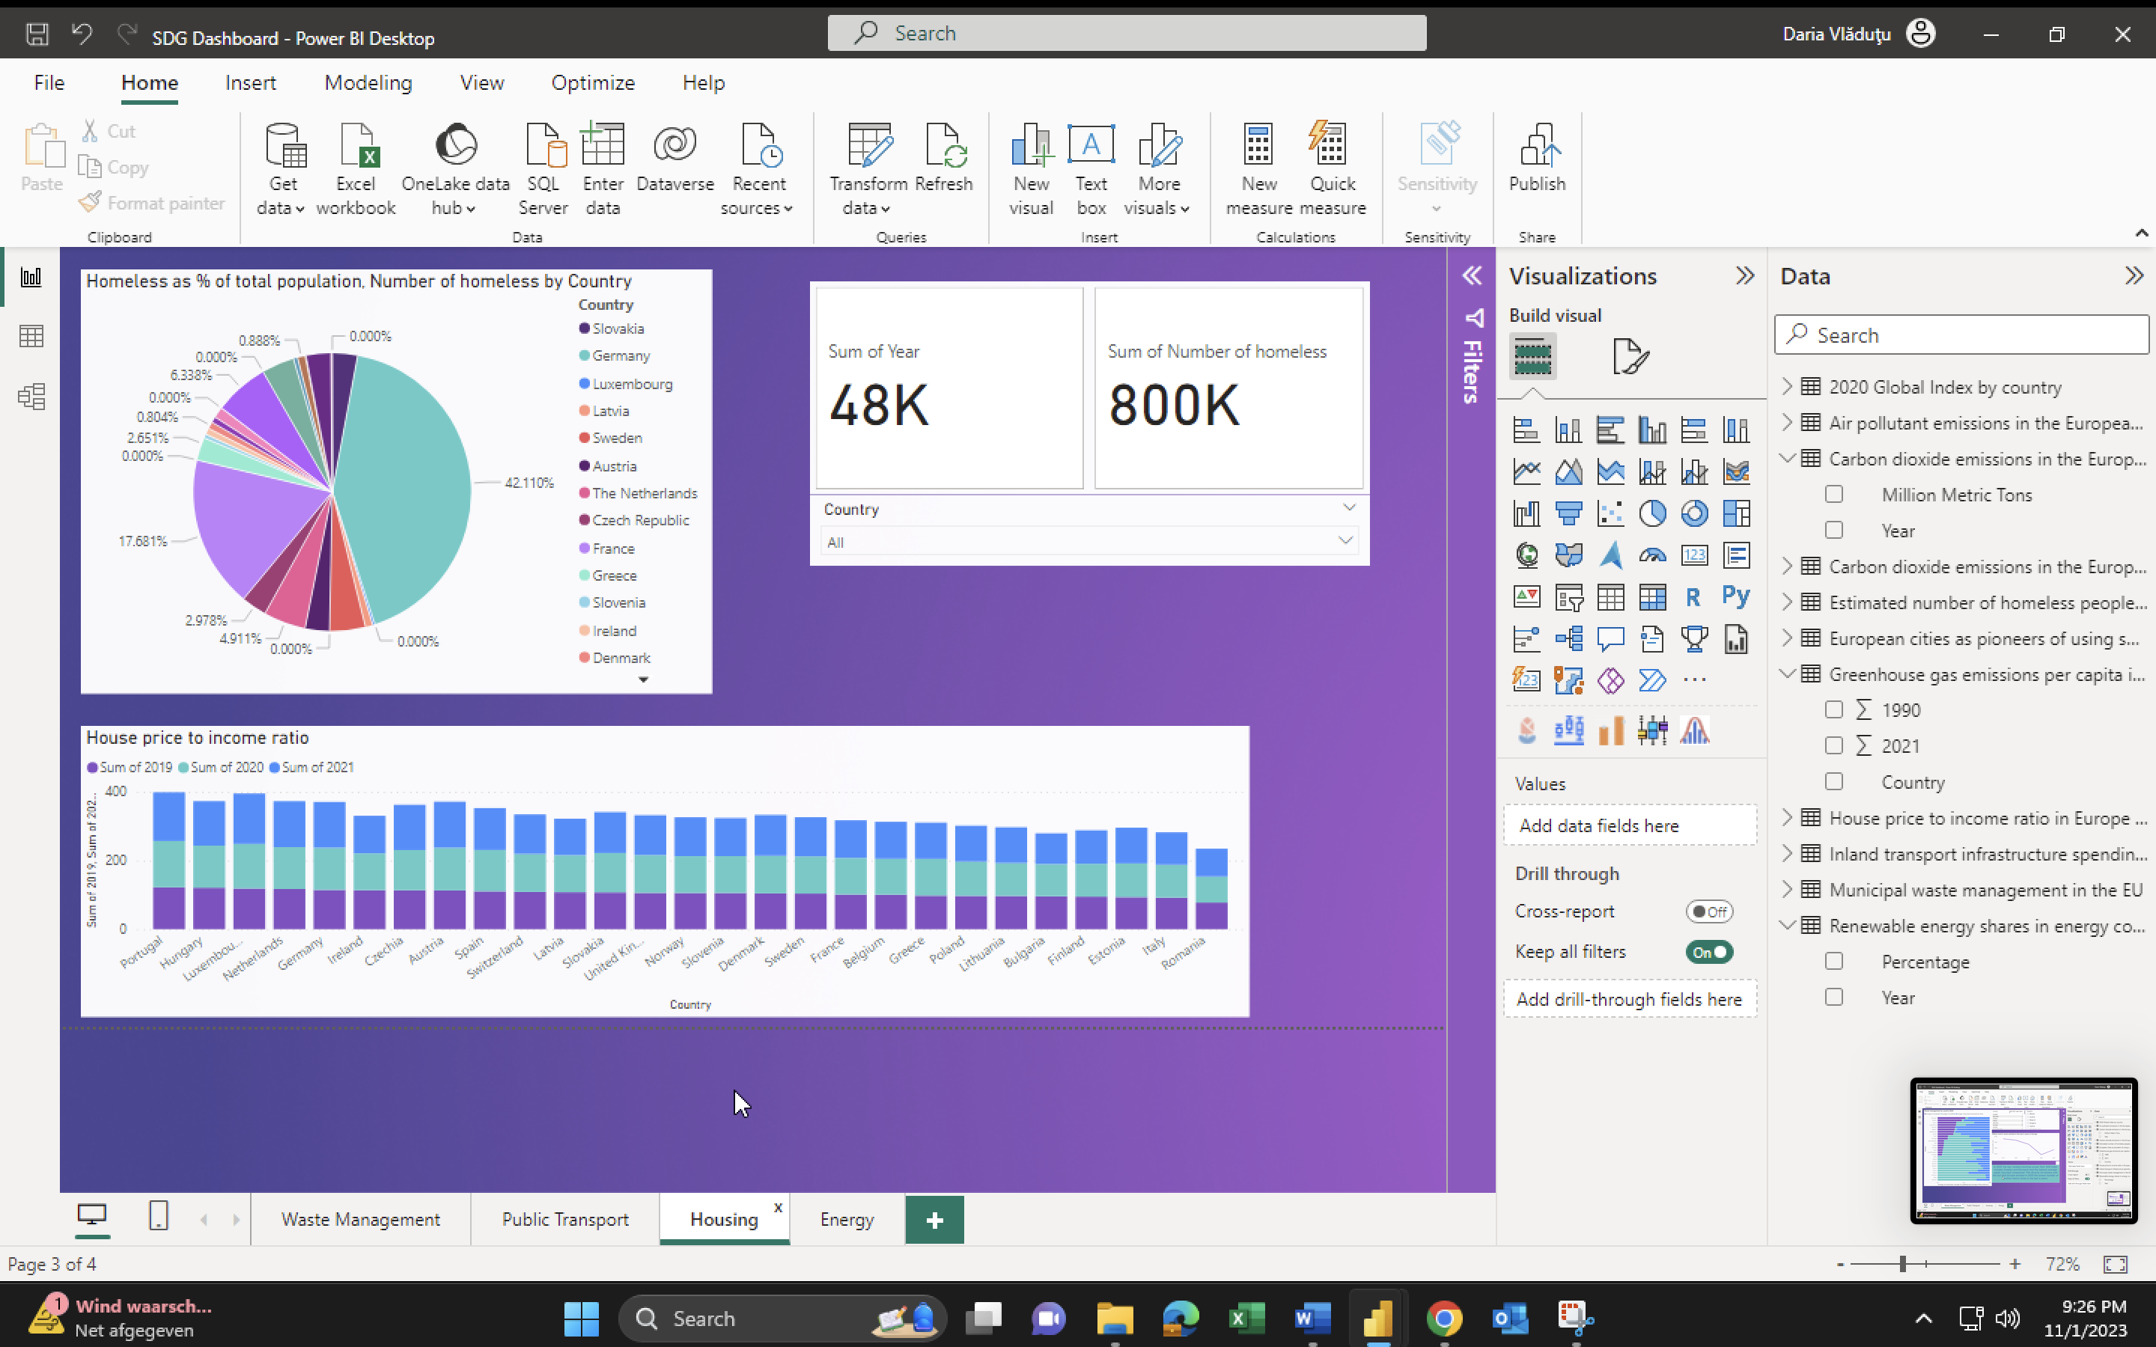
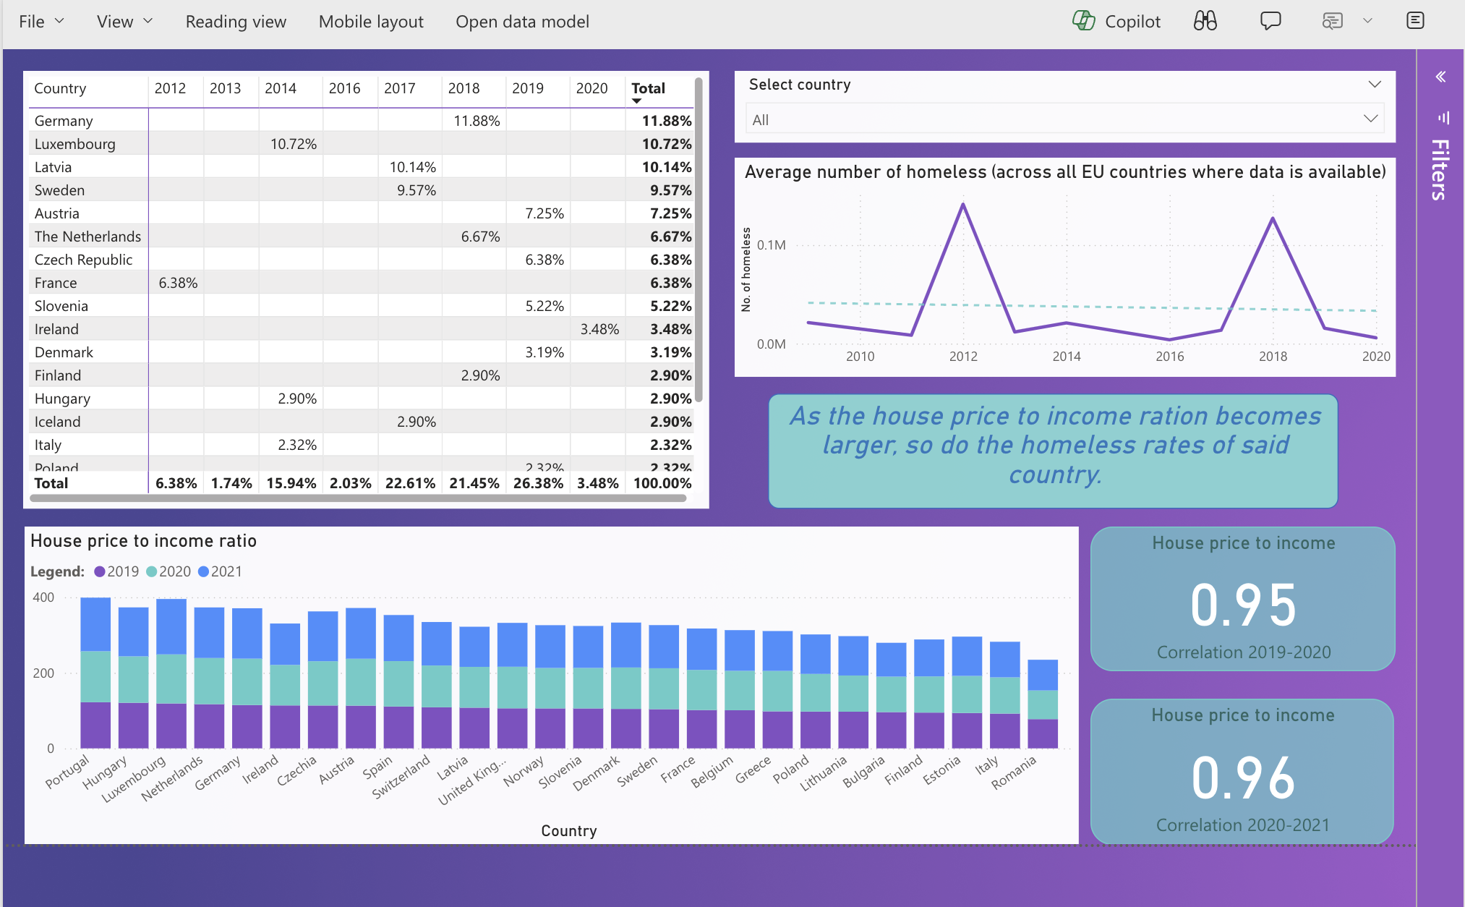
Changes made regarding the second opportunity – Before and After - Dashboard
RETAKE

Slide 41
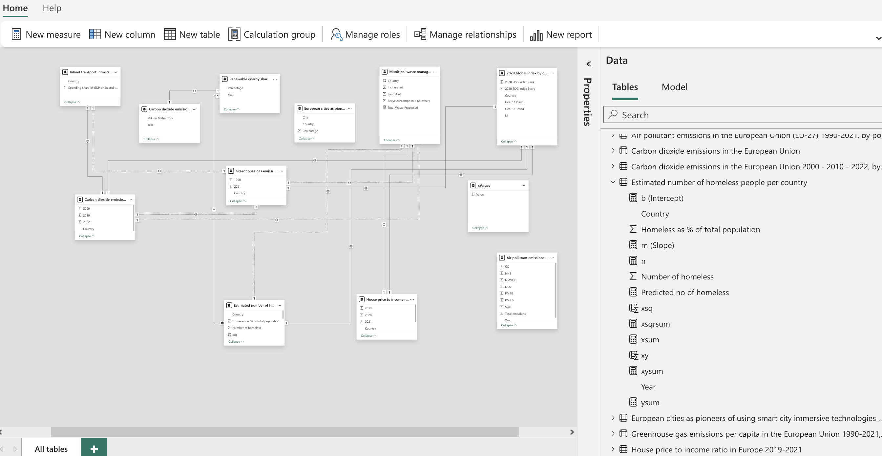
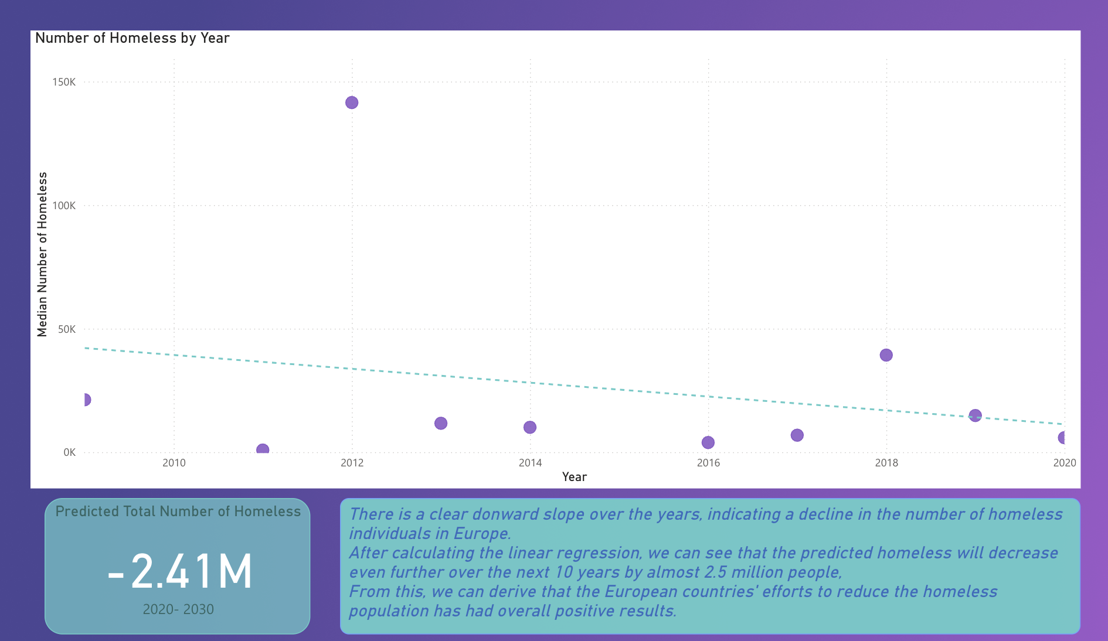
Changes made regarding the second opportunity
RETAKE
‘Homeless population’ tab
Added another tab as an extension of the ‘Homeless’ tab where I plotted a scatter chart between the number of homeless and the years, and where I added a trend line.
Calculated the linear relationship between the above-mentioned variables (y = mx + b) by creating new columns and measures, and predicted the total number of homeless people over the next 10 years.

Slide 42
Changes made regarding the second opportunity
RETAKE
‘Energy’ tab
Changed all the visuals in this tab.
Used a bar chart comparing the percentage of renewable energy shares in relation to million metric tones of carbon emissions in the EU.
Added a stacked column chart comparing the greenhouse gas emissions throughout Europe from 1990 and 2021 (difference of 11 years).
Added a map showcasing the biggest European pioneers of using smart immersive technologies in cities in 2020, I evidenced the correlation between renewable energy sources and European cities who not only adopted such technologies but also contributed to lowering gas emissions.
Added a text card to show the most important insights.

Slide 43
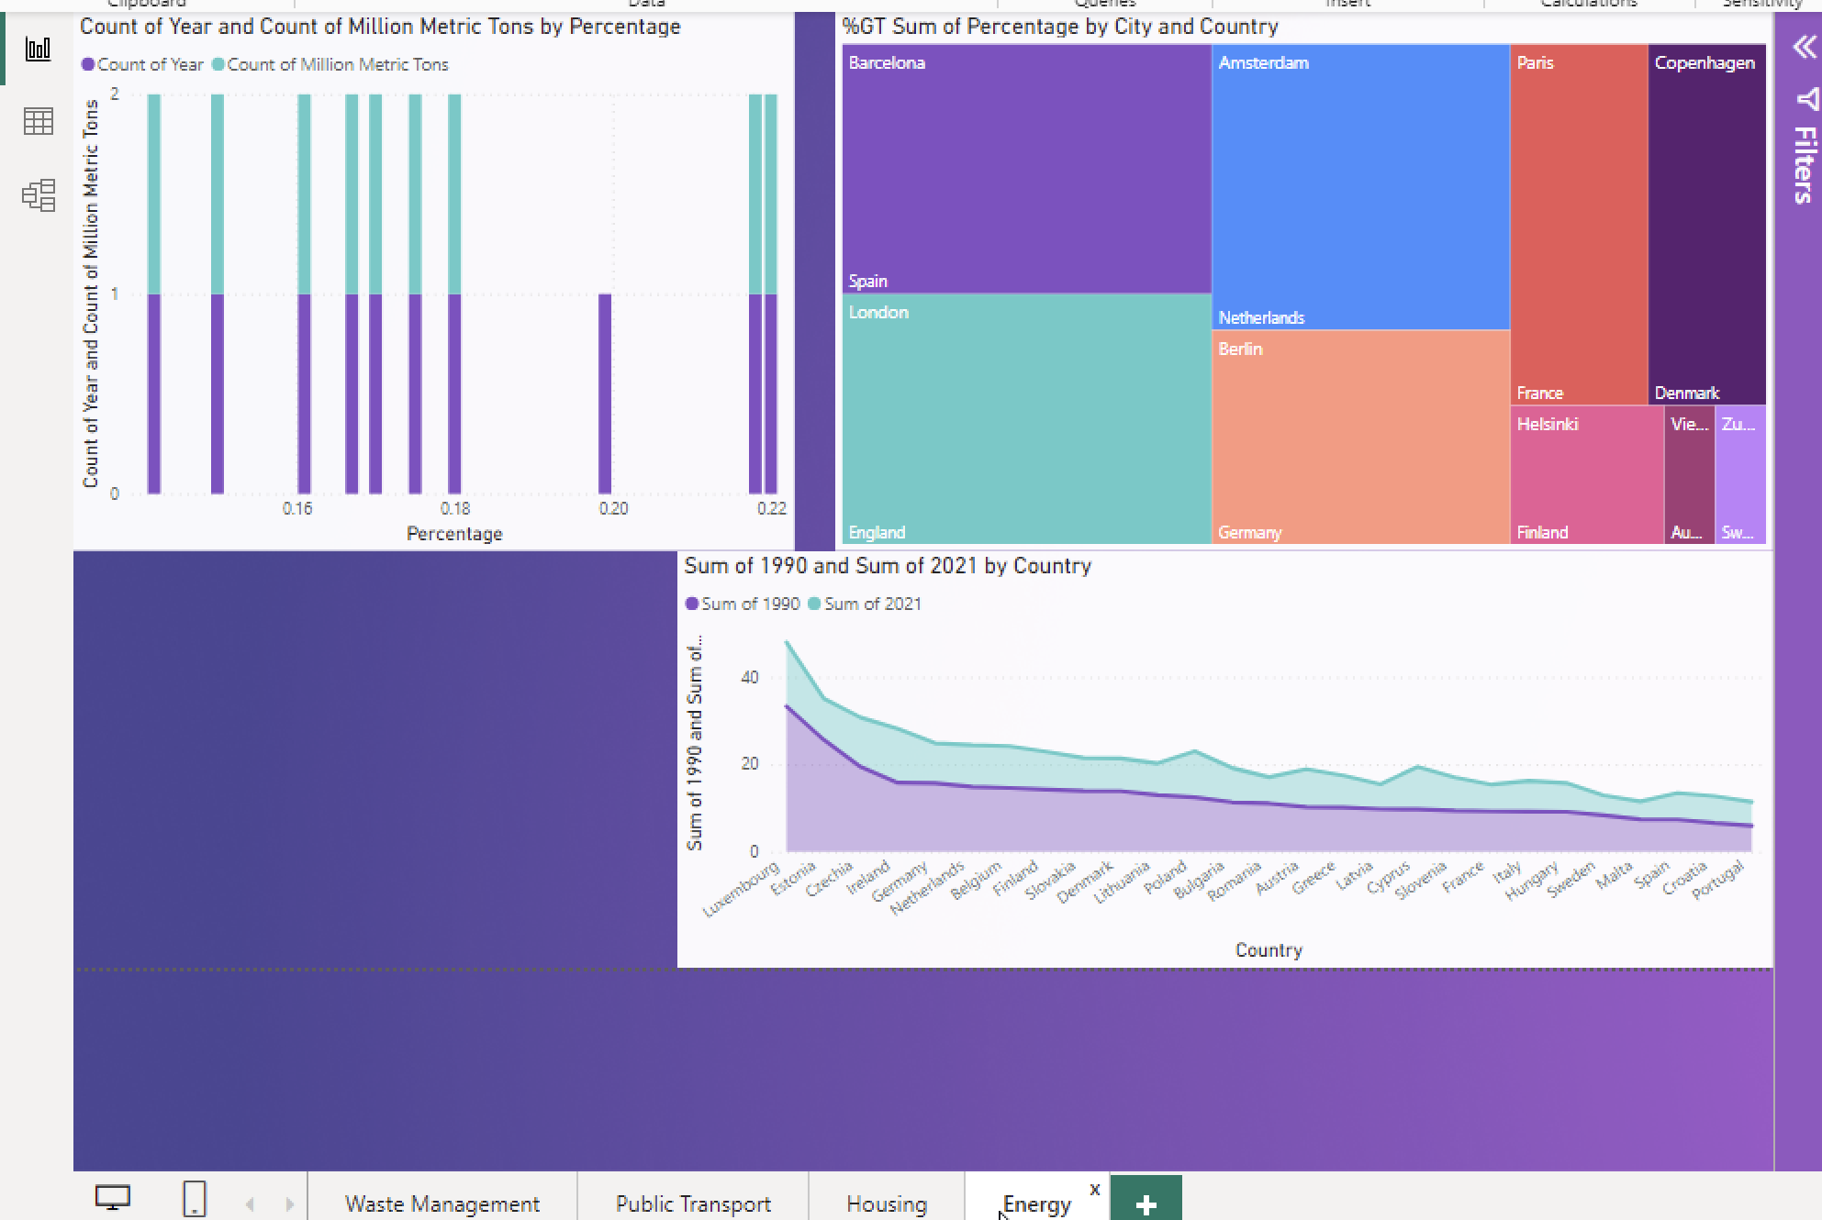
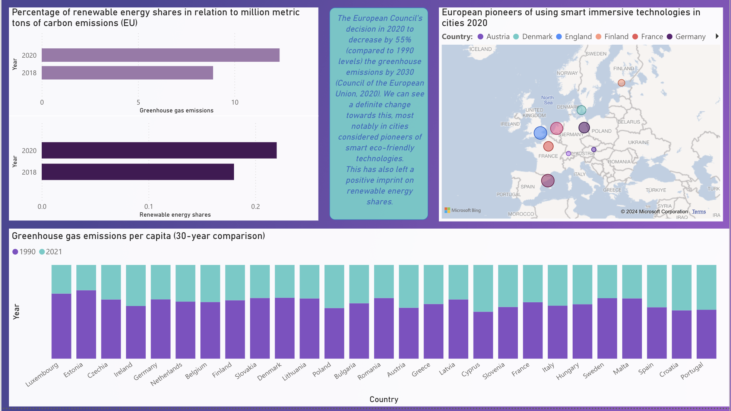
Changes made regarding the second opportunity – Before and After - Dashboard
RETAKE

Slide 44

Medal Challenges
Going the extra mile!

Slide 45
Medal Challenges
Going the extra mile!
1/1
Put your evidence down here to receive a medal!
Show your best examples, do not go overboard, add in short description, you are free to alter this layout (or add slides per evidence) to suit your needs. Just be sure that it is clear.

Slide 46
Section D
D
Reflection
Notes:
MUST BE COMPLETED IN WEEK 8
Summative reflection on your progress during the block including a critical assessment of everything you did and learned during the block. This is a comprehensive review of everything recorded in Section B, evaluated against the goals and planning laid out in Section A.

Slide 47
D
What did I achieve this block?
1/2
My most significant achievements this block
I would say my most significant achievement in this block has been understanding Python, which is a skill that I have wanted to learn for a long time, but felt like it was too difficult to achieve for my level of understanding of computer science. I was mistaken.
My most difficult challenges this block
Understanding PowerBI and its use in the Data Science career path has been quite challenging for me. I was quite lost at times when it came to applying the concepts learned and creating an interesting and useful dashboard. I especially struggled with incorporating the statistics learnings into the presentation, which I still believe are not quite well applied.
The most important lessons I learned
The most important lesson I have learned this block is the value of consistency and time management. Oftentimes, I fell behind on my weekly work due to poor time management, and in the end, I had to catch up, which resulted in additional stress and less sleep. I learned that there is always some task that I need to work on, no matter how insignificant, and that splitting the task into smaller, more manageable work is key to achieving a good grade.

Slide 48
D
How well am I progressing?
2/2
Reflection on my self assessment My self assessment grade is a
7.8
I believe this grade accurately reflects the work that I have done this block. I have put in quite a lot of effort I believe. However, I fell short when it came to meeting quiz deadlines and other DataLab Tasks. Additionally, I believe that my SDG presentation was not as good as it could have been.
How I plan to improve next block
My objective for the next block is to improve my time management and consistency so that I don't have as many instances of falling behind on my coursework as I did this block. Rather than becoming bogged down in the small tasks, I want to devote more time to the larger ones. Above all, I will make time for myself to unwind and attempt to strike a balance between my personal needs and my academic obligations.​

